Slide 1
Multivariate Blind Signatures Revisited
Ward Beullens
IBM Research - Zurich

Slide 2
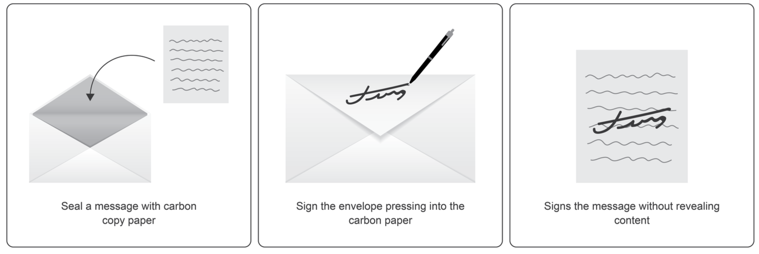
Blind signatures
Blind signatures are similar to normal digital signatures, but signing is distributed between a Client and Server.
Client has a message, Server has the secret key.
After some interaction the Client has a signature for his message, Server doesn’t learn anything about the message.
Security = One-more unforgeability and Blindness (Client Privacy)

Slide 3
Blind Signatures
Applications:
e-Cash (Chaum, Original application)
Privacy Pass
Anonymous credentials
e-Voting
…
Assumptions:
Classical Assumptions (RSA, ECC)
Lattice-based
Code-based
Isogeny-based
Multivariate

Slide 4

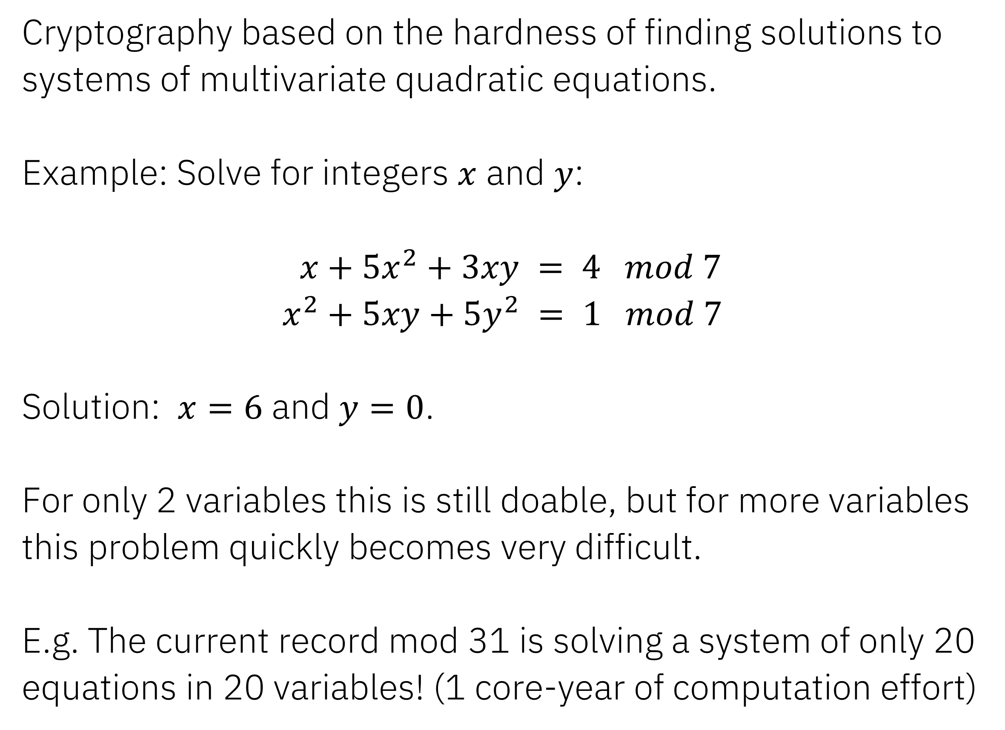
Multivariate Quadratic Cryptography
Cryptography based on the hardness of finding solutions to systems of multivariate quadratic equations.
Example: Solve for integers $x$ and $y$:
$x+5x^{2}+3xy = 4 mod 7$
$x^{2}+5xy+5y^{2} = 1 mod 7$
Solution: $x=6$ and $y=0$.
For only 2 variables this is still doable, but for more variables this problem quickly becomes very difficult.
E.g. The current record mod 31 is solving a system of only 20 equations in 20 variables! (1 core-year of computation effort)

Slide 5
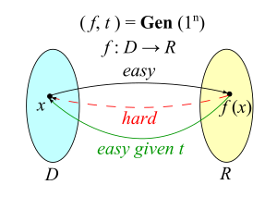
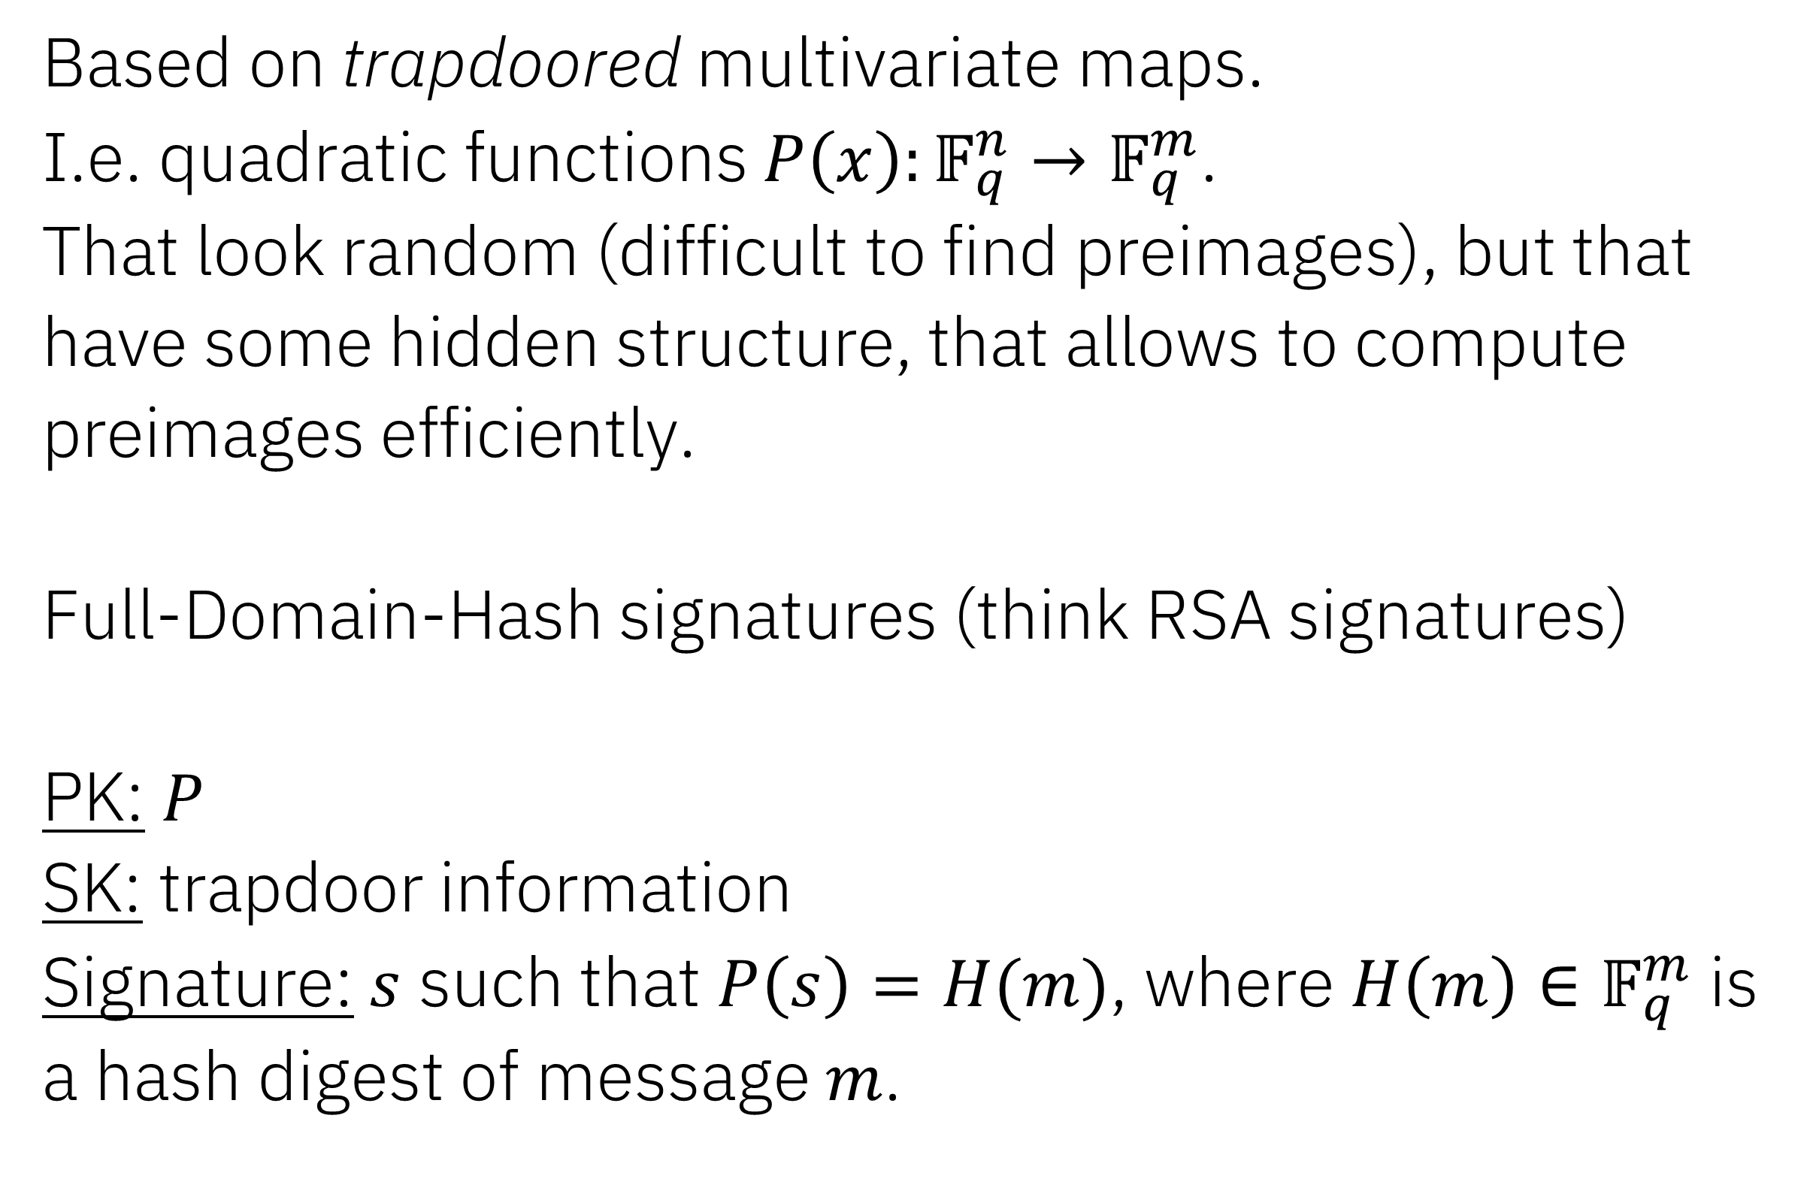
Multivariate trapdoors/signatures
Based on trapdoored multivariate maps.
I.e. quadratic functions $P\left(x\right):𝔽_{q}^{n}→𝔽_{q}^{m}$.
That look random (difficult to find preimages), but that have some hidden structure, that allows to compute preimages efficiently.
Full-Domain-Hash signatures (think RSA signatures)
PK: $P$
SK: trapdoor information
Signature: $s$ such that $P\left(s\right)=H(m)$, where $H\left(m\right)∈𝔽_{q}^{m}$ is a hash digest of message $m$.

Slide 6
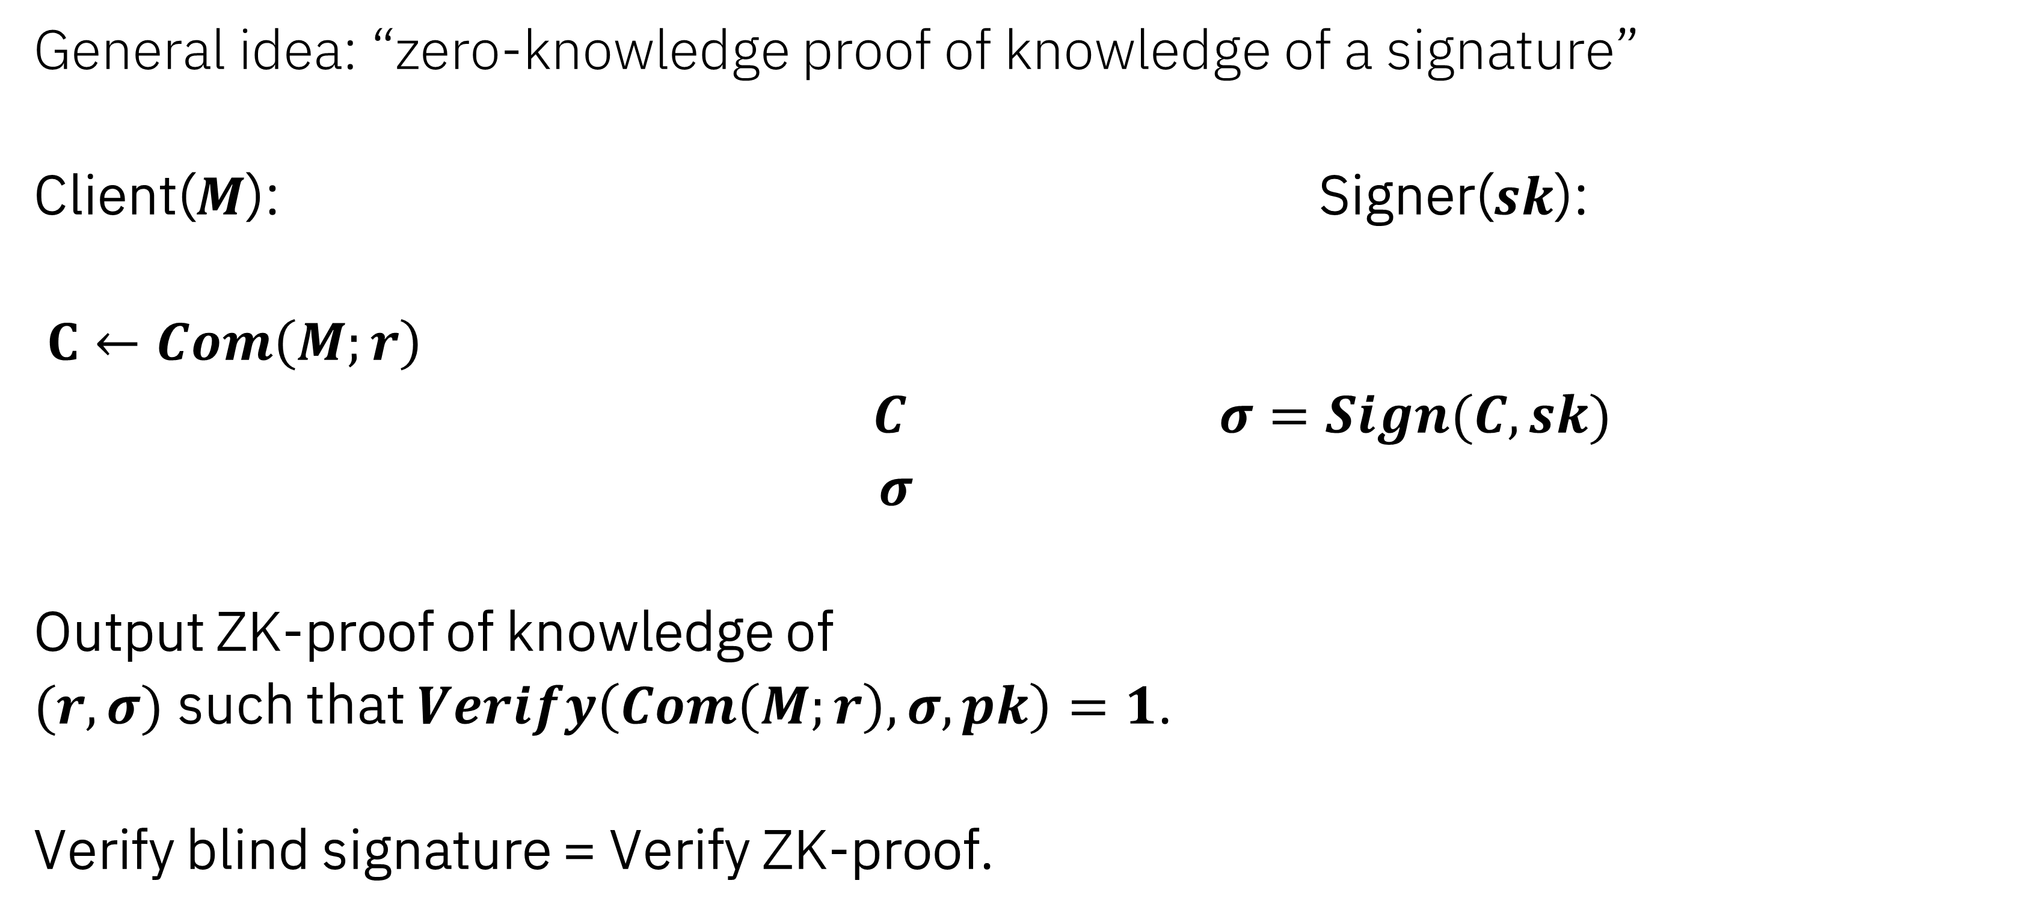
Generic blind signatures.
General idea: “zero-knowledge proof of knowledge of a signature”
Client($M$): Signer($sk$):
$C←Com\left(M;r\right)$
$C$ $σ=Sign(C, sk)$
$σ$
Output ZK-proof of knowledge of
$(r,σ)$ such that $Verify\left(Com\left(M;r\right),σ,pk\right)=1$.
Verify blind signature = Verify ZK-proof.

Slide 7

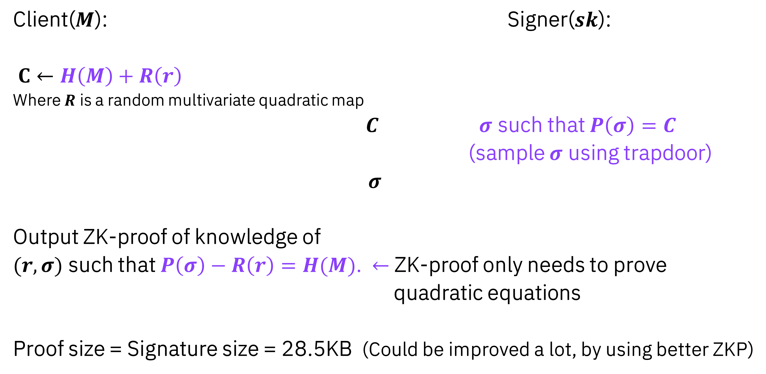
Multivariate blind signatures. [Petzoldt,Szepieniec,Mohamed 2017]
Client($M$): Signer($sk$):
$C←H\left(M\right)+R\left(r\right)$
Where $R$ is a random multivariate quadratic map
$C$ $σ$ such that $P\left(σ\right)=C$
(sample $σ$ using trapdoor)
$σ$
Output ZK-proof of knowledge of
$(r,σ)$ such that $P\left(σ\right)−R\left(r\right)=H(M)$. $←$ ZK-proof only needs to prove
quadratic equations
Proof size = Signature size = 28.5KB (Could be improved a lot, by using better ZKP)

Slide 8

Multivariate blind signatures. [Petzoldt,Szepieniec,Mohamed 2017]
Client($M$): Signer($sk$):
$C←H\left(M\right)+R\left(r\right)$
Where $R$ is a random multivariate quadratic map
$C$ $σ$ such that $P\left(σ\right)=C$
(sample $σ$ using trapdoor)
$σ$
Output ZK-proof of knowledge of
$(r,σ)$ such that $P\left(σ\right)+R\left(r\right)=H(M)$. $←$ ZK-proof only needs to prove
quadratic equations
Proof size = Signature size = 28.5KB (Could be improved a lot, by using better ZKP)
NOT SECURE!

Slide 9
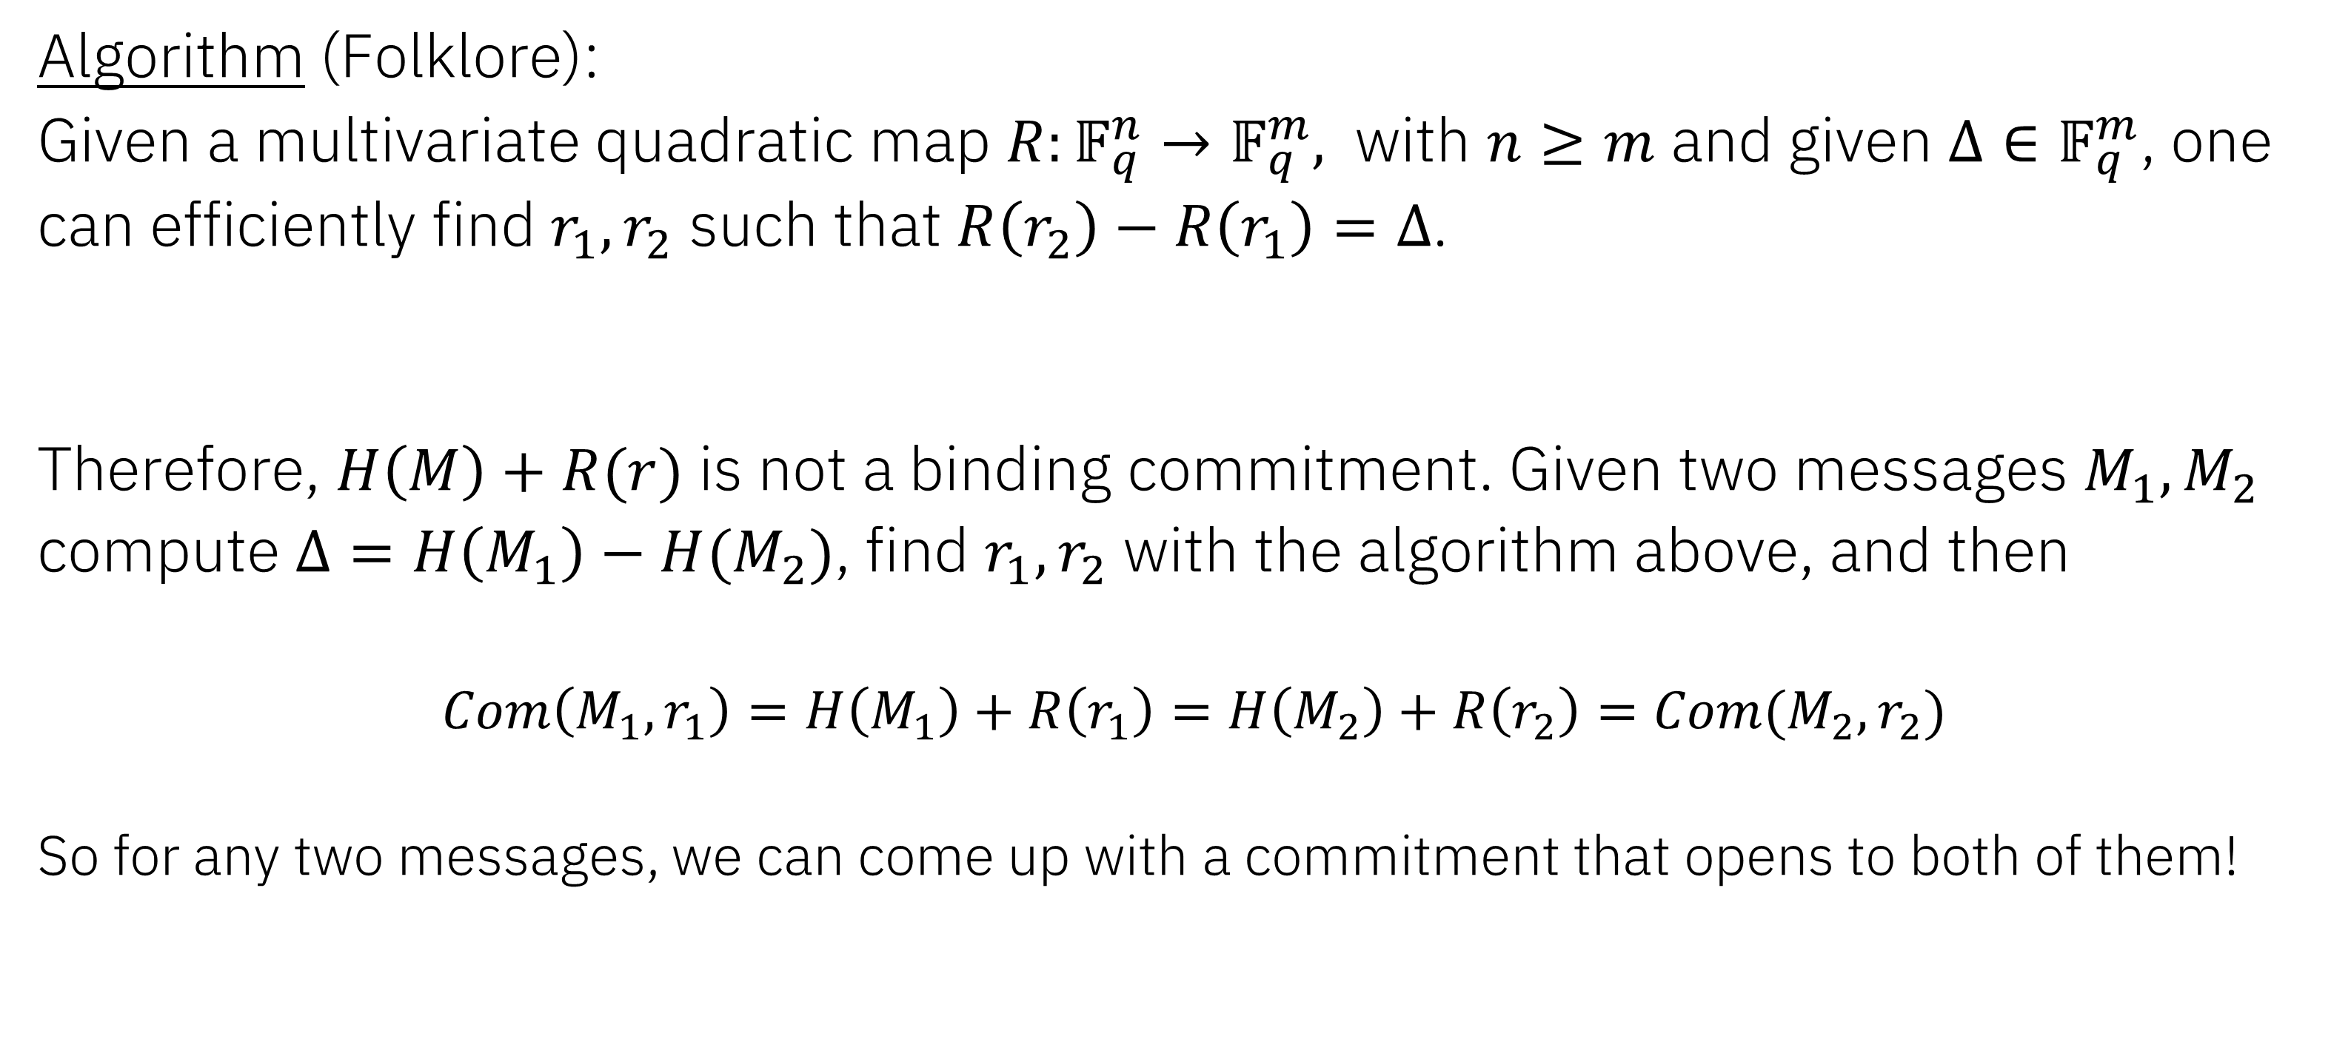
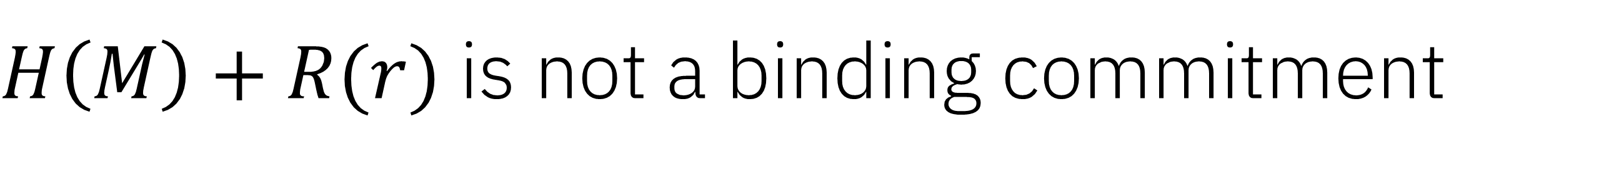
$H\left(M\right)+R(r)$ is not a binding commitment
Algorithm (Folklore):
Given a multivariate quadratic map $R:𝔽_{q}^{n}→𝔽_{q}^{m},$ with $n≥m$ and given $Δ∈𝔽_{q}^{m}$, one can efficiently find $r_{1},r_{2}$ such that $R\left(r_{2}\right)−R\left(r_{1}\right)=Δ$.
Therefore, $H\left(M\right)+R(r)$ is not a binding commitment. Given two messages $M_{1},M_{2}$ compute $Δ=H\left(M_{1}\right)−H(M_{2})$, find $r_{1},r_{2}$ with the algorithm above, and then
$$Com\left(M_{1},r_{1}\right)=H\left(M_{1}\right)+R\left(r_{1}\right)=H\left(M_{2}\right)+R\left(r_{2}\right)=Com(M_{2},r_{2})$$
So for any two messages, we can come up with a commitment that opens to both of them!

Slide 10
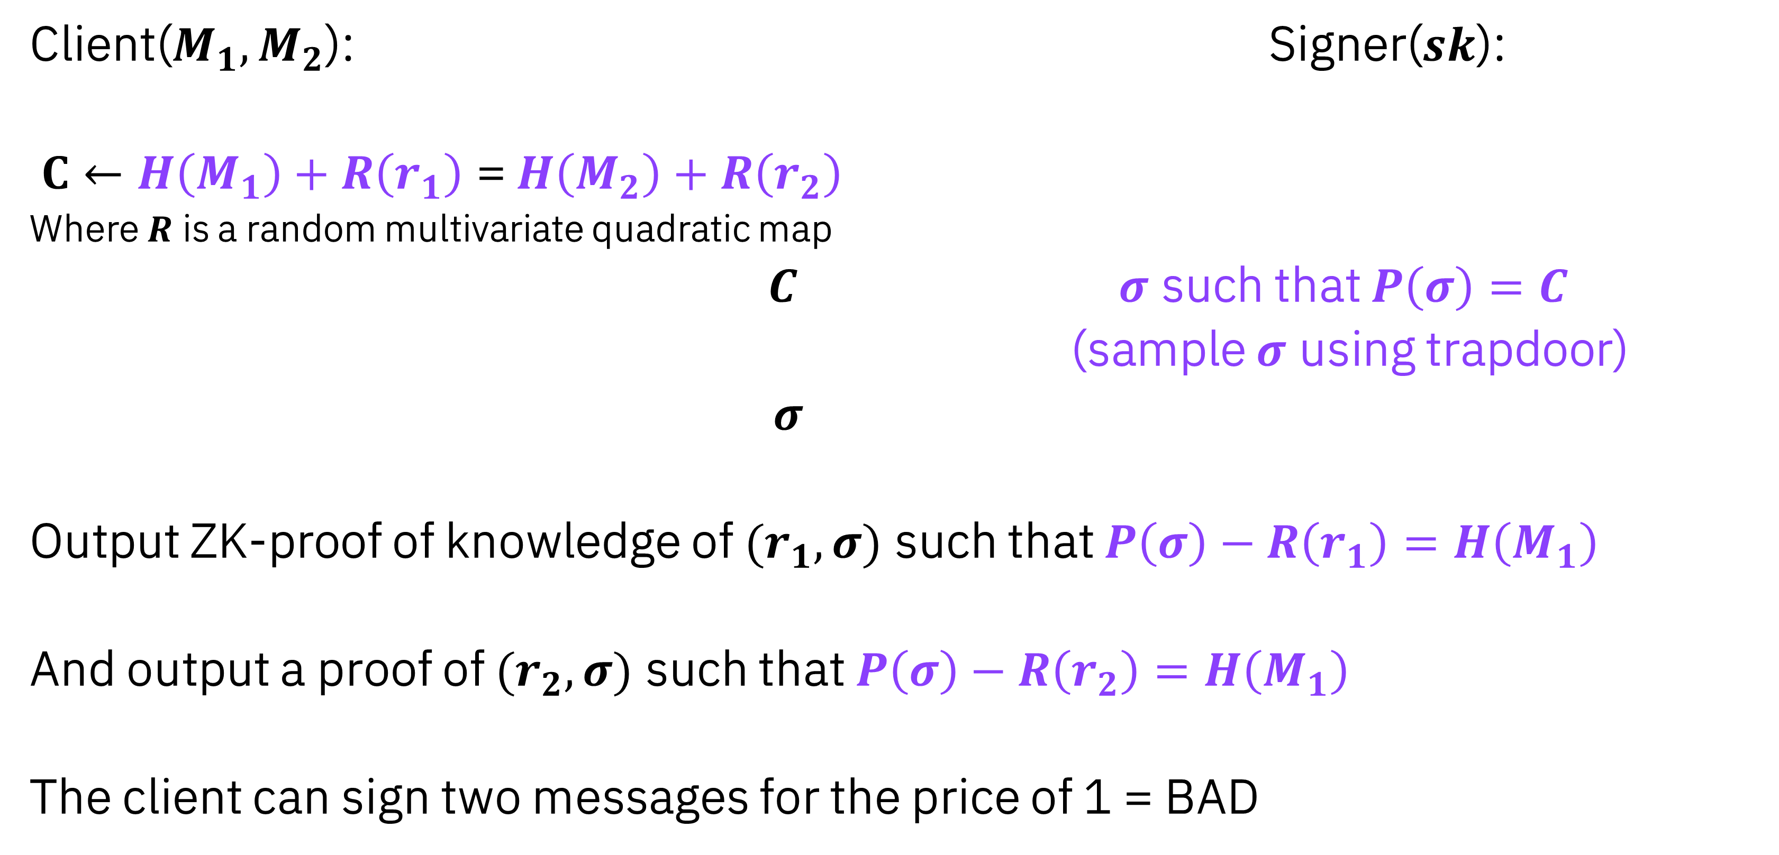
Attack on Multivariate blind signatures.
Client($M_{1},M_{2}$): Signer($sk$):
$C←H\left(M_{1}\right)+R\left(r_{1}\right)$ = $H\left(M_{2}\right)+R\left(r_{2}\right)$
Where $R$ is a random multivariate quadratic map
$C$ $σ$ such that $P\left(σ\right)=C$
(sample $σ$ using trapdoor)
$σ$
Output ZK-proof of knowledge of $(r_{1},σ)$ such that $P\left(σ\right)−R\left(r_{1}\right)=H\left(M_{1}\right)$
And output a proof of $(r_{2},σ)$ such that $P\left(σ\right)−R\left(r_{2}\right)=H\left(M_{1}\right)$
The client can sign two messages for the price of 1 = BAD

Slide 11
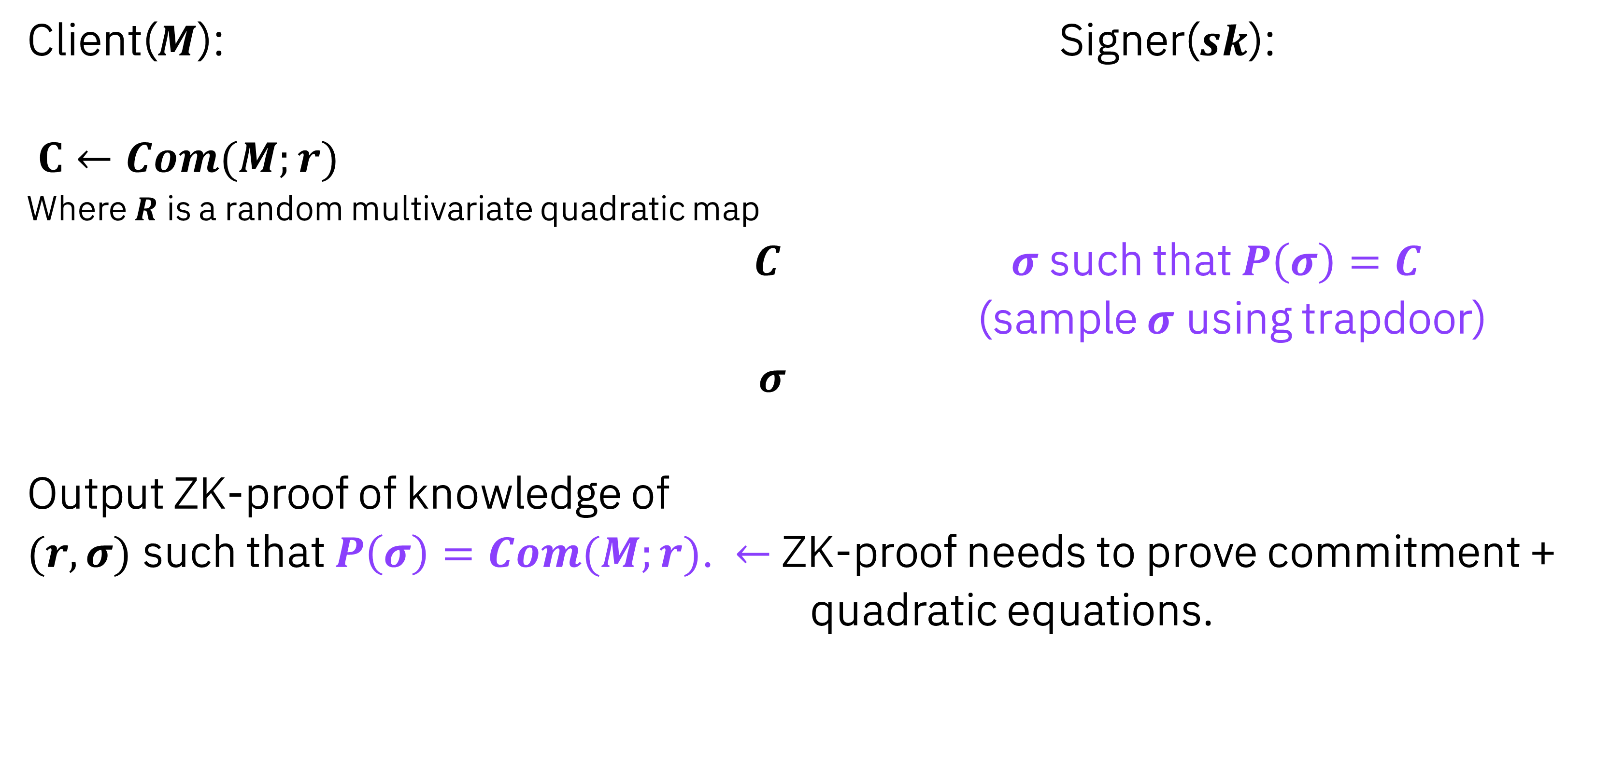
Countermeasure: use a proper commitment scheme
Client($M$): Signer($sk$):
$C←Com(M;r)$
Where $R$ is a random multivariate quadratic map
$C$ $σ$ such that $P\left(σ\right)=C$
(sample $σ$ using trapdoor)
$σ$
Output ZK-proof of knowledge of
$(r,σ)$ such that $P\left(σ\right)=Com(M;r)$. $←$ ZK-proof needs to prove commitment +
quadratic equations.

Slide 12
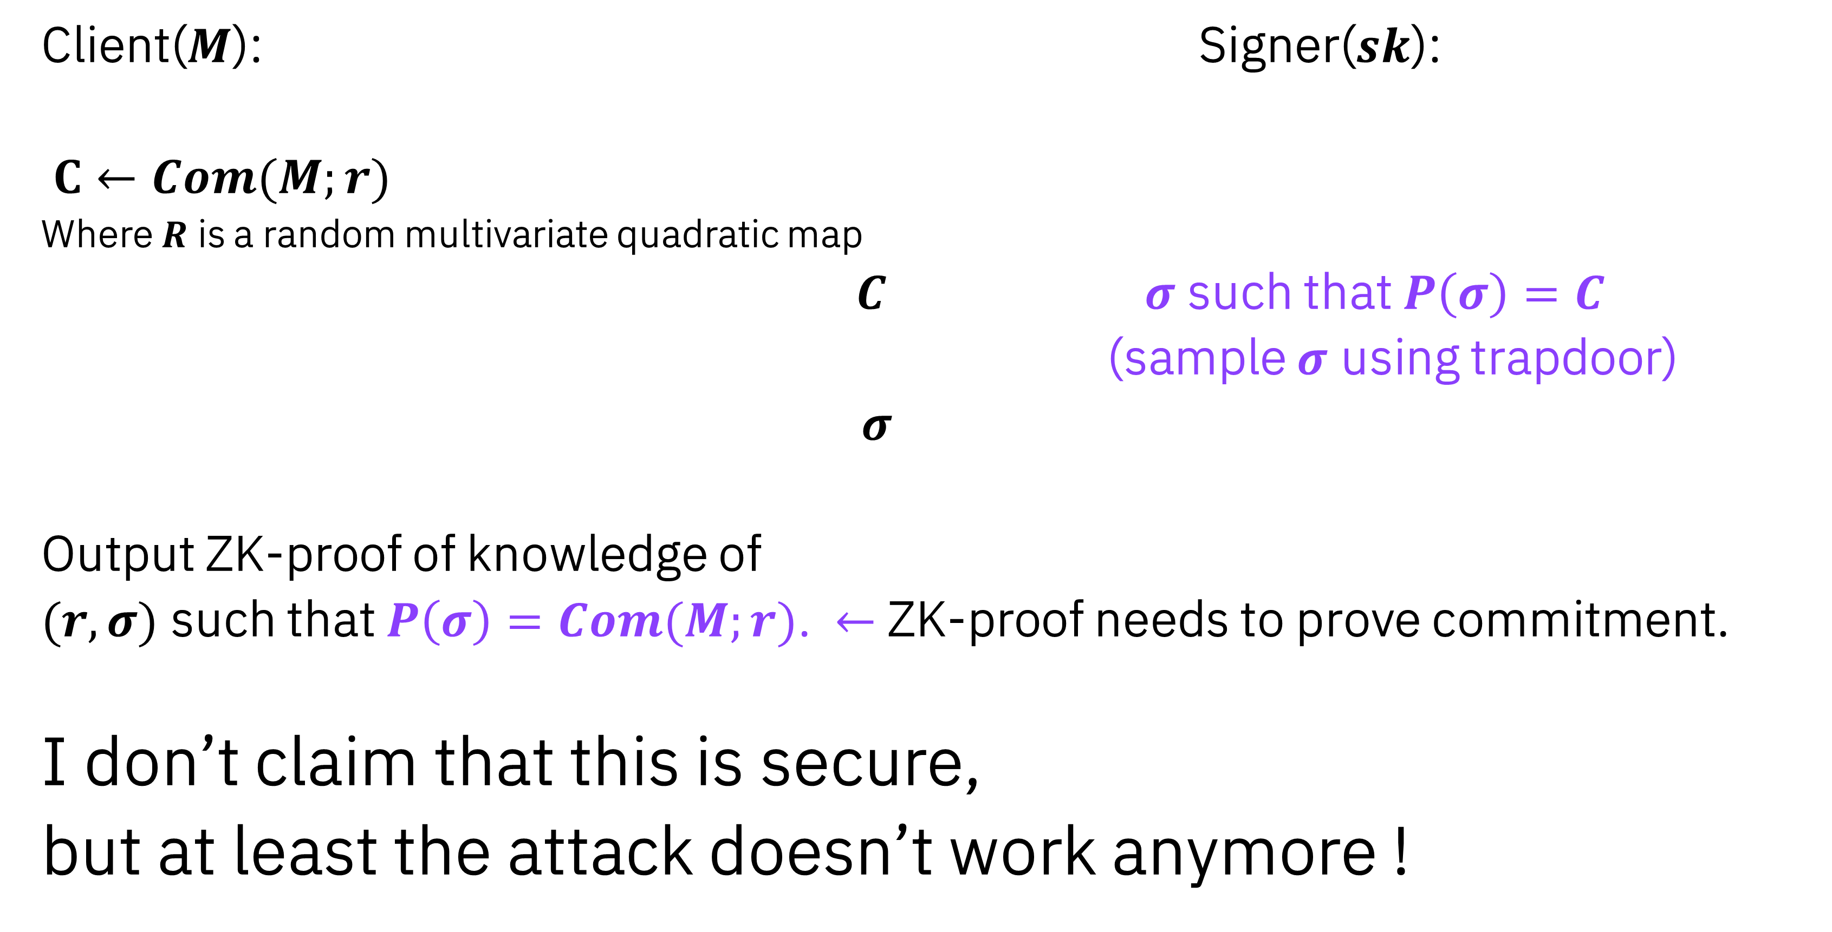
Countermeasure: use a proper commitment scheme
Client($M$): Signer($sk$):
$C←Com(M;r)$
Where $R$ is a random multivariate quadratic map
$C$ $σ$ such that $P\left(σ\right)=C$
(sample $σ$ using trapdoor)
$σ$
Output ZK-proof of knowledge of
$(r,σ)$ such that $P\left(σ\right)=Com(M;r)$. $←$ ZK-proof needs to prove commitment.
I don’t claim that this is secure,
but at least the attack doesn’t work anymore !

Slide 13

How to break the commitment scheme?
We will use the so-called polar form of a quadratic map.
Definition: (Polar form)
Let $P\left(x\right):𝔽_{q}^{n}→𝔽_{q}^{m}$, be a homogeneous multivariate quadratic map. Then we define the polar form of $P$ as:
$P^{′}\left(x,y\right):=P\left(x+y\right)−P\left(x\right)−P\left(y\right)$
Then $P′\left(x,y\right)$ is symmetric: $P^{′}\left(x,y\right)=P′(y,x)$
And bilinear:
$$P\left(αx+{βx}^{′},y\right)=αP\left(x,y\right)+βP(x^{′},y)$$
$$P\left(x,αy+βy′\right)=αP\left(x,y\right)+βP(x,y′)$$

Slide 14

How to break the commitment scheme?
Algorithm for finding $r_{1},r_{2}$ such that $Δ=R\left(r_{2}\right)−R(r_{1})$:
1) Pick ${Δ_{r}:= r}_{2}−r_{1}∈$ $𝔽_{q}^{n}$ uniformly at random.
2) Solve for $r_{1}$ such that $(r_{1}, r_{2}=r_{1}+Δ_{r})$ is a solution.
Step 2) is easy because it comes down to solving a system of linear(!) equations.
$$Δ=R\left(r_{2}\right)−R(r_{1 })$$

Slide 15

How to break the commitment scheme?
Algorithm for finding $r_{1},r_{2}$ such that $Δ=R\left(r_{2}\right)−R(r_{1})$:
1) Pick ${Δ_{r}:= r}_{2}−r_{1}∈$ $𝔽_{q}^{n}$ uniformly at random.
2) Solve for $r_{1}$ such that $(r_{1}, r_{2}=r_{1}+Δ_{r})$ is a solution.
Step 2) is easy because it comes down to solving a system of linear(!) equations.
$$Δ=R\left(r_{1}+Δ_{r}\right)−R(r_{1 })$$

Slide 16

How to break the commitment scheme?
Algorithm for finding $r_{1},r_{2}$ such that $Δ=R\left(r_{2}\right)−R(r_{1})$:
1) Pick ${Δ_{r}:= r}_{2}−r_{1}∈$ $𝔽_{q}^{n}$ uniformly at random.
2) Solve for $r_{1}$ such that $(r_{1}, r_{2}=r_{1}+Δ_{r})$ is a solution.
Step 2) is easy because it comes down to solving a system of linear(!) equations.
$$Δ=R\left(r_{1}+Δ_{r}\right)−R(r_{1 })$$
$$=R\left(r_{1}\right)+R\left(Δ_{r}\right)+R^{′}\left(r_{1},Δ_{r}\right)−R(r_{1})$$

Slide 17

How to break the commitment scheme?
Algorithm for finding $r_{1},r_{2}$ such that $Δ=R\left(r_{2}\right)−R(r_{1})$, with $R:𝔽_{q}^{n}→𝔽_{q}^{m},$ with $n≥m$ .
1) Pick ${Δ_{r}:= r}_{2}−r_{1}∈$ $𝔽_{q}^{n}$ uniformly at random.
2) Solve for $r_{1}$ such that $(r_{1}, r_{2}=r_{1}+Δ_{r})$ is a solution.
Step 2) is easy because it comes down to solving a system of linear(!) equations.
$$Δ=R\left(r_{1}+Δ_{r}\right)−R(r_{1 })$$
$$Δ=R\left(r_{1}\right)+R\left(Δ_{r}\right)+R^{′}\left(r_{1},Δ_{r}\right)−R\left(r_{1}\right)$$
Is a system of $m$ linear equations in $n$ variables, so one can efficiently find a solution.
(Which is likely to exist if $n≥m$)

Slide 18
Conclusions
Multivariate quadratic maps are not binding commitments.
The blind signature scheme of Petzoldt et al. is not one-more unforgeable.
It might be possible to fix the scheme by using a proper commitment.
Future work:
Try to prove that the fixed blind signature scheme is secure under reasonable assumptions.

