Slide 1
Multi-User Dynamic Searchable Encryption for Prefix-Fixing Predicates from Symmetric-Key Primitives
Icons: Material Design by Google | Apache License Version 2.0
Font Awesome by Dave Gandy | CC BY 3.0 _
SAC 2024
Takato Hirano¹, Yutaka Kawai¹, Yoshihiro Koseki¹, Satoshi Yasuda¹,
Yohei Watanabe², Takumi Amada², Mitsugu Iwamoto², Kazuo Ohta²
Mitsubishi Electric Corporation, Japan
The University of Electro-Communications, Japan

Slide 2


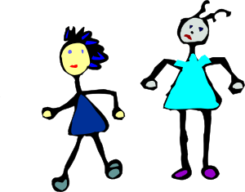
Privacy on Databases
How do we securely utilize a database?
It contains various sensitive information
We want to use fundamental operations such as “update” and “search” in a privacy-preserving way
Cryptographic solution: Encrypted search (more broadly, encrypted database)
Searchable encryption, oblivious RAM, multiparty computation, fully homomorphic encryption, functional encryption, deterministic encryption, property-preserving encryption, etc.

Slide 3

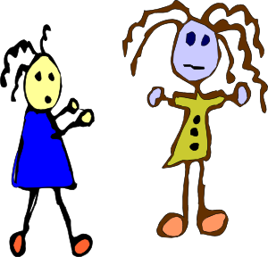

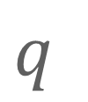


Dynamic Searchable Symmetric Encryption (SSE) [Curtmola-Garay-Kamara-Ostrovsky, CCS’06 & JourCS’11], [Kamara-Papamanthou-Roeder, CCS’12]
Enables a client (user) to update and search an encrypted database
Leaks no information but (pre-determined) “inconsequential” data
Update
Ciphertext
file
SK
Update Info
Client (User)
Leakage
Search
$$q$$
$$q$$
$$q$$
$$⋯$$
Keyword
SK
Trapdoor
Client (User)
Update
Search Result
Leakage

Slide 4
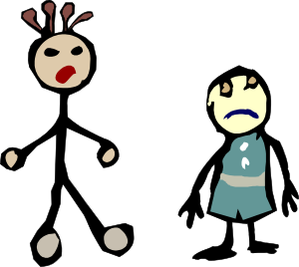
How to Manage Multiple Users
Naïve approach: Sharing the secret key among all users
If some user leaks it, then the security of SSE is immediately compromised
SK
SK
SK
Users
SK
SK

Slide 5
Multi-User SSE (MUSE) with Flexible Access Control
First MUSE [Curtmola-Garay-Kamara-Ostrovsky, CCS’06 & JourCS’11]
Achieves collusion resistance by using broadcast encryption [Fiat-Naor, C’93]
Various lines of recent research on MUSE
Multi-Writer/Multi-Reader setting
[Michalas, ACSAC’19], [Michalas, NordSec’19], [Wang-Chow, NDSS’24]
Multi-Writer/Single-Reader setting
[Wang-Chow, USENIX Sec’22], [Meng-Chen-Tian-Manulis-Liu, USENIX Sec’24]
Incl. Public-key encryption with keyword search (PEKS) [Boneh-Crescenzo-Ostrovsky-Persiano, EC’04]
Single-Writer/Multi-Reader setting (this work)
[Jarecki-Jutla-Krawczyk-Rosu-Steiner, CCS’13], [Karmanshahi-Liu-Steinfeld-Nepal-Lai-Loh-Zuo, IEEE Trans. Depend. Sec. Comp.’21], [Chamani-Wang-Papadopoulos-Zhang-Jalili, IEEE Trans. Depend. Sec. Comp.’23]

Slide 6
Limitations in Existing MUSE Model and Constructions
Access Control (e.g., [Chamani-Wang-Papadopoulos-Zhang-Jalili, IEEE Trans. Depend. Sec. Comp.’23])
Only support restricted access control
User secret keys associated with keywords, not attributes
Model (e.g., [Michalas, ACSAC’19], [Michalas, NordSec’19])
Require a trusted third-party or trusted execution environment (TEE)
Construction (e.g., , [Meng-Chen-Tian-Manulis-Liu, USENIX Sec’24], [Wang-Chow, NDSS’24])
Employ the following public-key primitives/techniques
IBE and ABE, which imply rich algebraic structures such as pairing and lattices
Algebraic structures, such as pairings and RSA/DDH-based approaches
Security (e.g., [Dang-Ullah-Bakas-Michalas, ACNS Workshop’20], [Yang-Liu-Luo-Hong-Li-Xue, Globecom’22])
Provide no security proofs

Slide 7
Our Contributions: New MUSE with Reasonable Access Control
Propose a new dynamic MUSE scheme that:
Supports reasonable and flexible access control
Specifically, our MUSE scheme supports prefix-fixing predicates
Rely on no trusted authority and TEEs during the search operations
Constructed from only symmetric-key primitives
Our MUSE scheme is built from only hash functions (modeled as random oracles)
Provably secure in the random oracle model
Under some leakage, which seems acceptable but could be improved
Not forward and backward private
Left for future work

Slide 8



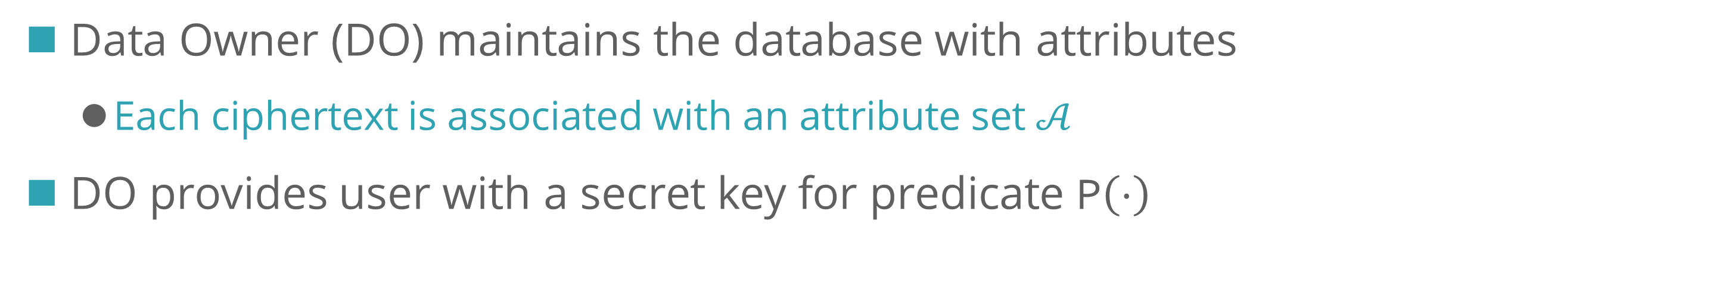





MUSE: Model (for Database Updates and Key Generation)
Data Owner (DO) maintains the database with attributes
Each ciphertext is associated with an attribute set $𝒜$
DO provides user with a secret key for predicate $\text{P}\left(⋅\right)$
MSK
Ciphertext
File
Enc
$$𝒜$$
Data Owner
Leakage
Attributes
Update Info
$$\text{P}$$
$$\text{P}′$$
$$\text{P}′′$$
MSK
$$\text{P}\left(⋅\right)$$
$$\text{P}$$
KeyGen
Predicate
SK for $\text{P}$
Users
Update

Slide 9



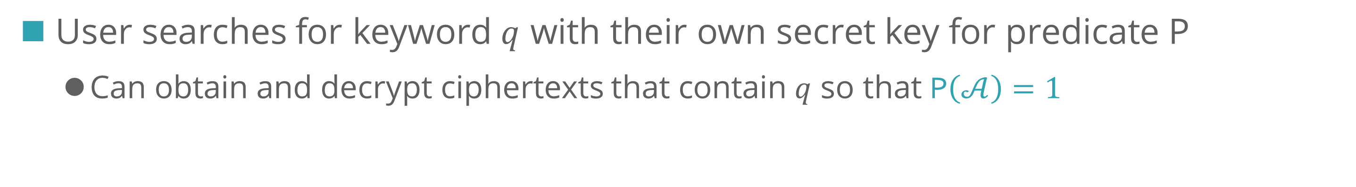


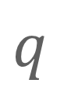



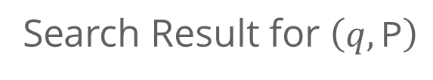

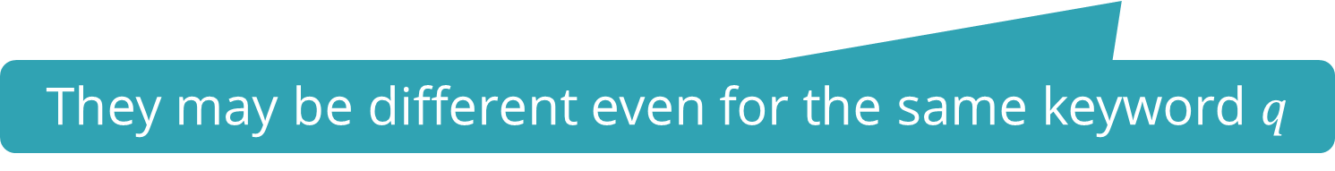



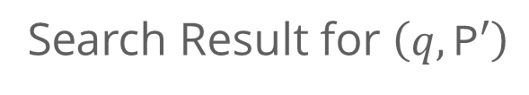

MUSE: Model (for Keyword Search)
User searches for keyword $q$ with their own secret key for predicate $\text{P}$
Can obtain and decrypt ciphertexts that contain $q$ so that $\text{P}\left(𝒜\right)=1$
$$\text{P}$$
$$\text{P}$$
$$\text{P}$$
$$q$$
$$q$$
$$q$$
Srch
Keyword
Trapdoor
$$⋯$$
Search Result for $\left(q,\text{P}\right)$
Leakage
They may be different even for the same keyword $q$
$$\text{P}′$$
$$\text{P}′$$
$$\text{P}′$$
$$q$$
$$q$$
$$q$$
Srch
Keyword
Trapdoor
$$⋯$$
Search Result for $\left(q,\text{P}′\right)$
Leakage

Slide 10

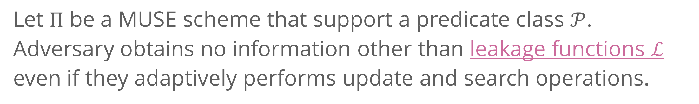
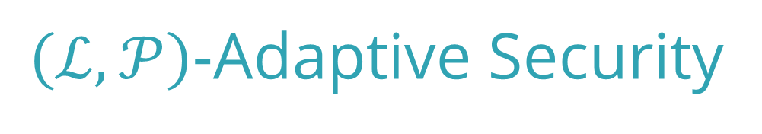
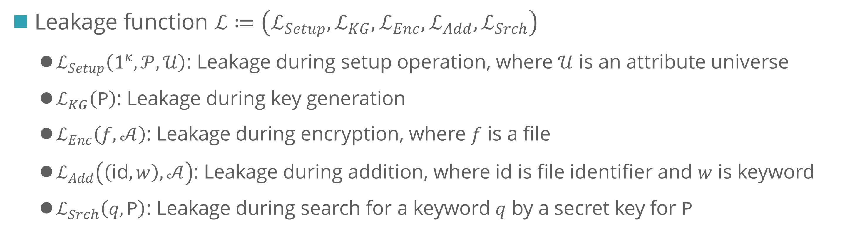
$\left(ℒ,𝒫\right)$-Adaptive Security: Overview and Leakage Functions
Note: $ℒ$ itself might leak
some important information
$\left(ℒ,𝒫\right)$-Adaptive Security
Let $Π$ be a MUSE scheme that support a predicate class $𝒫$.
Adversary obtains no information other than leakage functions $ℒ$ even if they adaptively performs update and search operations.
Leakage function $ℒ≔\left(ℒ_{Setup},ℒ_{KG},ℒ_{Enc},ℒ_{Add},ℒ_{Srch}\right)$
$ℒ_{Setup}\left(1^{κ},𝒫,𝒰\right)$: Leakage during setup operation, where $𝒰$ is an attribute universe
$ℒ_{KG}\left(\text{P}\right)$: Leakage during key generation
$ℒ_{Enc}\left(f,𝒜\right)$: Leakage during encryption, where $f$ is a file
$ℒ_{Add}\left(\left(\text{i}\text{d},w\right),𝒜\right)$: Leakage during addition, where $\text{id}$ is file identifier and $w$ is keyword
$ℒ_{Srch}\left(q,\text{P}\right)$: Leakage during search for a keyword $q$ by a secret key for $\text{P}$

Slide 11








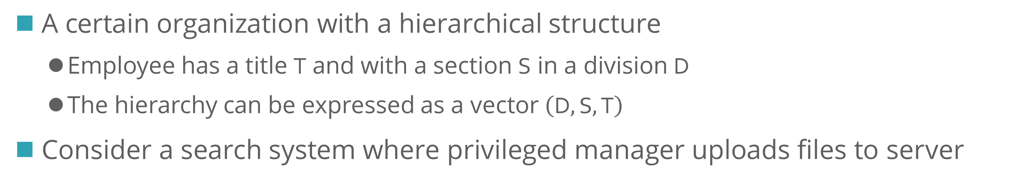




Motivating Scenario for Our MUSE
A certain organization with a hierarchical structure
Employee has a title $\text{T}$ and with a section $\text{S}$ in a division $\text{D}$
The hierarchy can be expressed as a vector $\left(\text{D},\text{S},\text{T}\right)$
Consider a search system where privileged manager uploads files to server
$${\text{D}}_{1}$$
$${\text{D}}_{2}$$
$${\text{S}}_{1}$$
$${\text{S}}_{2}$$
$${\text{S}}_{1}$$
Boss
Boss
$${\text{T}}_{1}$$
$${\text{T}}_{2}$$
Boss
$${\text{T}}_{1}$$
Boss
Boss
$${\text{T}}_{3}$$

Slide 12







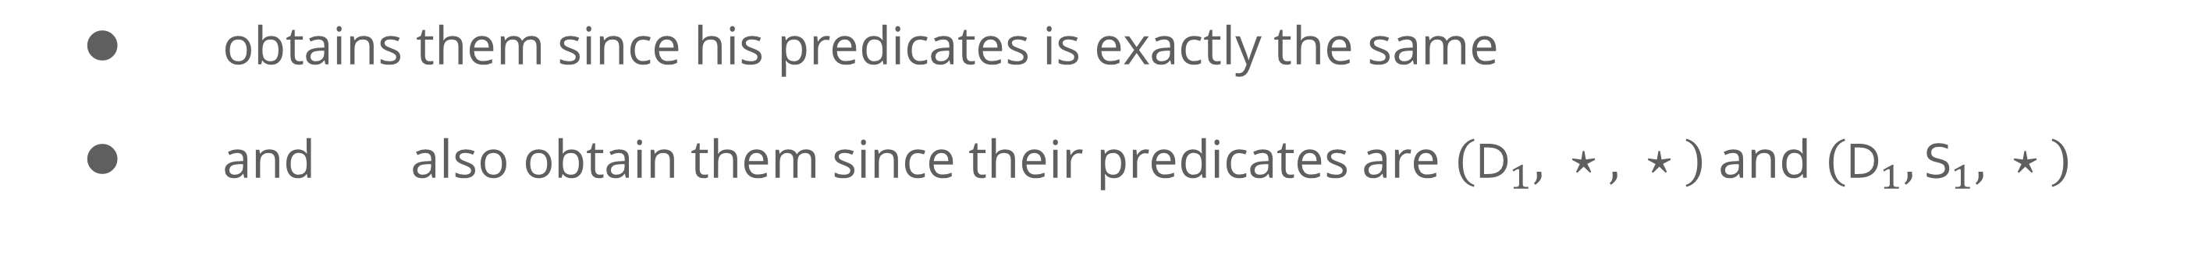



Motivating Scenario for Our MUSE
$${\text{D}}_{1}$$
$${\text{D}}_{2}$$
$${\text{S}}_{1}$$
$${\text{S}}_{2}$$
$${\text{S}}_{1}$$
Boss
Boss
$${\text{T}}_{1}$$
$${\text{T}}_{2}$$
Boss
$${\text{T}}_{1}$$
Boss
Boss
$${\text{T}}_{3}$$
Consider encrypted files for $\left({\text{D}}_{1},{\text{S}}_{1},{\text{T}}_{1}\right)$
obtains them since his predicates is exactly the same
and also obtain them since their predicates are $\left({\text{D}}_{1}, ⋆ , ⋆ \right)$ and $\left({\text{D}}_{1},{\text{S}}_{1}, ⋆ \right)$
Wildcard $⋆$ is allowed to use

Slide 13
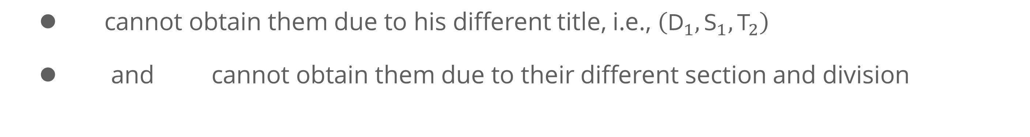
Motivating Scenario for Our MUSE
$${\text{D}}_{1}$$
$${\text{D}}_{2}$$
$${\text{S}}_{1}$$
$${\text{S}}_{2}$$
$${\text{S}}_{1}$$
Boss
Boss
$${\text{T}}_{1}$$
$${\text{T}}_{2}$$
Boss
$${\text{T}}_{1}$$
Boss
Boss
$${\text{T}}_{3}$$
Consider encrypted files for $\left({\text{D}}_{1},{\text{S}}_{1},{\text{T}}_{1}\right)$
cannot obtain them due to his different title, i.e., $\left({\text{D}}_{1},{\text{S}}_{1},{\text{T}}_{2}\right)$
and cannot obtain them due to their different section and division

Slide 14
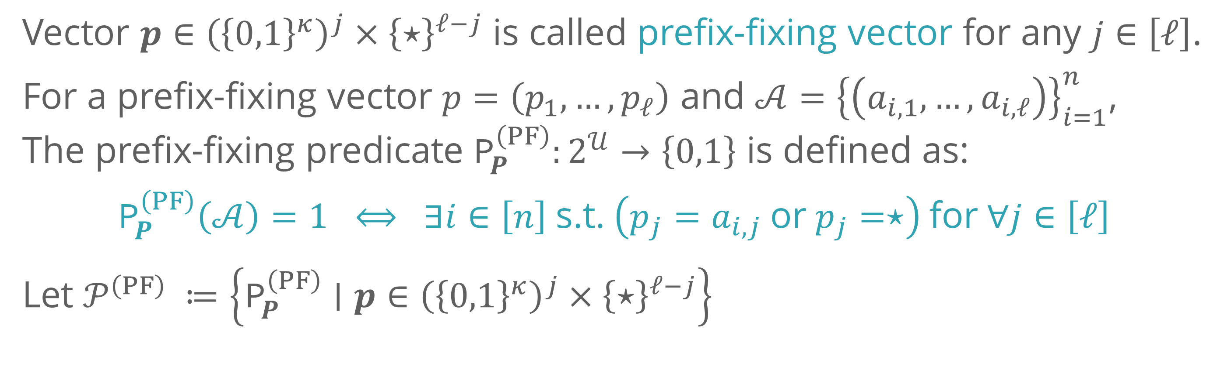
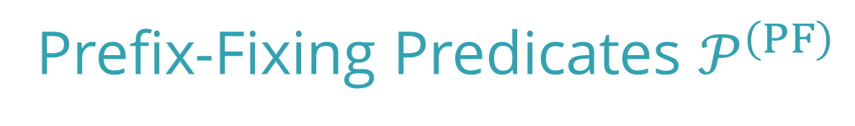
Predicates for Our MUSE: Prefix-Fixing Predicates
Expresses the hierarchical structure in the previous slides
Previously considered in the context of constrained pseudorandom functions [Boneh-Waters, AC’13], [Boyle-Goldwasser-Ivan, PKC’14]
Prefix-Fixing Predicates $𝒫^{\left(PF\right)}$
Vector $p∈{\left({\left\{0,1\right\}}^{κ}\right)}^{j}×{\left\{⋆\right\}}^{ℓ−j}$ is called prefix-fixing vector for any $j∈\left[ℓ\right]$.
For a prefix-fixing vector $p=\left(p_{1},…,p_{ℓ}\right)$ and $𝒜={\left\{\left(a_{i,1},…,a_{i,ℓ}\right)\right\}}_{i=1}^{n}$,
The prefix-fixing predicate ${\text{P}}_{P}^{\left(PF\right)}:2^{𝒰}→\left\{0,1\right\}$ is defined as:
$${\text{P}}_{P}^{\left(PF\right)}\left(𝒜\right)=1 ⟺ ∃i∈\left[n\right] \text{s}\text{.}\text{t}\text{.} \left(p_{j}=a_{i,j} \text{or} p_{j}=⋆\right) \text{for} ∀j∈\left[ℓ\right]$$
Let $𝒫^{\left(PF\right)} ≔\left\{{\text{P}}_{P}^{\left(PF\right)}∣p∈{\left({\left\{0,1\right\}}^{κ}\right)}^{j}×{\left\{⋆\right\}}^{ℓ−j}\right\}$

Slide 15

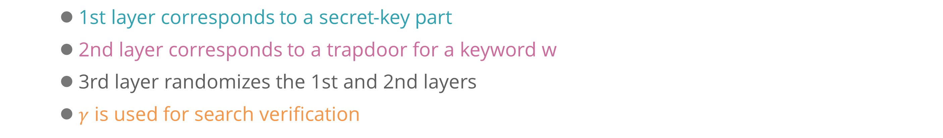
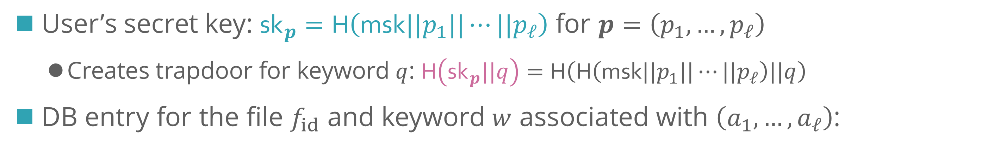
Our MUSE Construction: Overview
We construct a MUSE scheme from only hash functions
DO’s master secret key $\text{msk}$ is used as a secret seed for the hash function
User’s secret key: ${\text{sk}}_{p}=\text{H}\left(\text{msk}||p_{1}||⋯||p_{ℓ}\right)$ for $p=\left(p_{1},…,p_{ℓ}\right)$
Creates trapdoor for keyword $q$: $\text{H}\left({\text{sk}}_{p}||q\right)=\text{H}\left(\text{H}\left(\text{msk}||p_{1}||⋯||p_{ℓ}\right)||q\right)$
DB entry for the file $f_{id}$ and keyword $w$ associated with $\left(a_{1},…,a_{ℓ}\right)$:
Randomly choose $t,γ←{\left\{0,1\right\}}^{κ}$
$${\text{tag}}_{1},…,{\text{tag}}_{ℓ}$$
Compute $\text{H}\left(\text{H}\left(\text{H}\left(\text{msk}||a_{1}||⋆||⋯||⋆\right)||w\right)||t\right)⊕γ,…,\text{H}\left(\text{H}\left(\text{H}\left(\text{msk}||a_{1}||⋯||a_{ℓ}\right)||w\right)||t\right)⊕γ$
1st layer corresponds to a secret-key part
2nd layer corresponds to a trapdoor for a keyword w
3rd layer randomizes the 1st and 2nd layers
$γ$ is used for search verification
DB entry is $\left(\text{id},t,{\text{tag}}_{1}…,{\text{tag}}_{ℓ},{\text{tag}}_{v}\right)$, where ${\text{tag}}_{v}≔\text{H}\left(γ\right)$

Slide 16





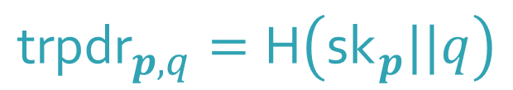
Our MUSE Construction: Overview
User’s secret key: ${\text{sk}}_{p}=\text{H}\left(\text{msk}||p_{1}||⋯||p_{ℓ}\right)$ for $p=\left(p_{1},…,p_{ℓ}\right)$
Creates trapdoor for keyword $q$: $\text{H}\left({\text{sk}}_{p}||q\right)=\text{H}\left(\text{H}\left(\text{msk}||p_{1}||⋯||p_{ℓ}\right)||q\right)$
DB entry for the file $f_{id}$ and keyword $w$ associated with $\left(a_{1},…,a_{ℓ}\right)$:
Compute $\text{H}\left(\text{H}\left(\text{H}\left(\text{msk}||a_{1}||⋆||⋯||⋆\right)||w\right)||t\right)⊕γ,…,\text{H}\left(\text{H}\left(\text{H}\left(\text{msk}||a_{1}||⋯||a_{ℓ}\right)||w\right)||t\right)⊕γ$
DB entry is $\left(\text{id},t,{\text{tag}}_{1}…,{\text{tag}}_{ℓ},{\text{tag}}_{v}\right)$, where ${\text{tag}}_{v}≔\text{H}\left(γ\right)$
$${\text{tag}}_{1},…,{\text{tag}}_{ℓ}$$
$${\text{sk}}_{p}=\text{H}\left(\text{msk}||p_{1}||⋯||p_{j}||⋆||⋯||⋆\right)$$
$$\text{msk}$$
For every $j∈\left[ℓ\right]$
$$γ^{′}=\text{H}\left({\text{trpdr}}_{p,q}||t\right)⊕{\text{tag}}_{j}$$
If ${\text{tag}}_{v}=\text{H}\left(γ^{′}\right)$,
return $\text{id}$
$${\text{trpdr}}_{p,q}=\text{H}\left({\text{sk}}_{p}||q\right)$$
$$\text{id}$$
Data Owner
Users

Slide 17
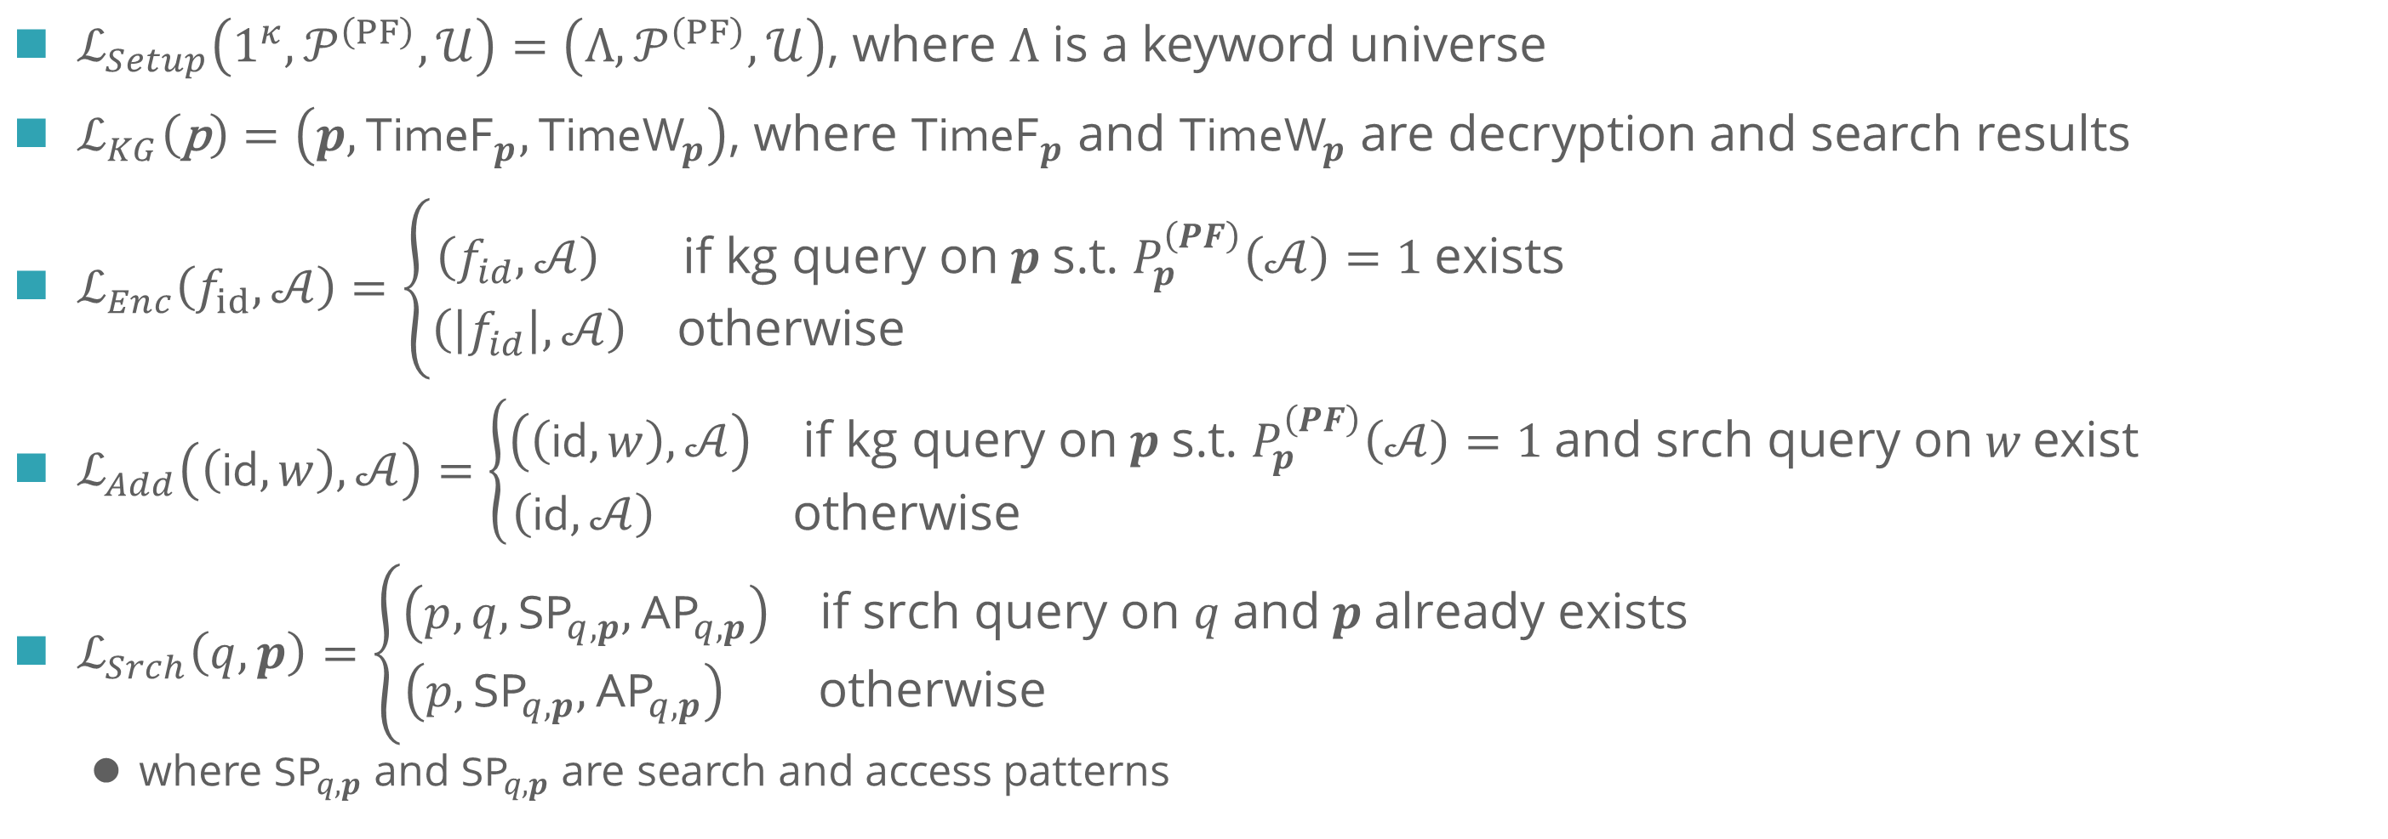
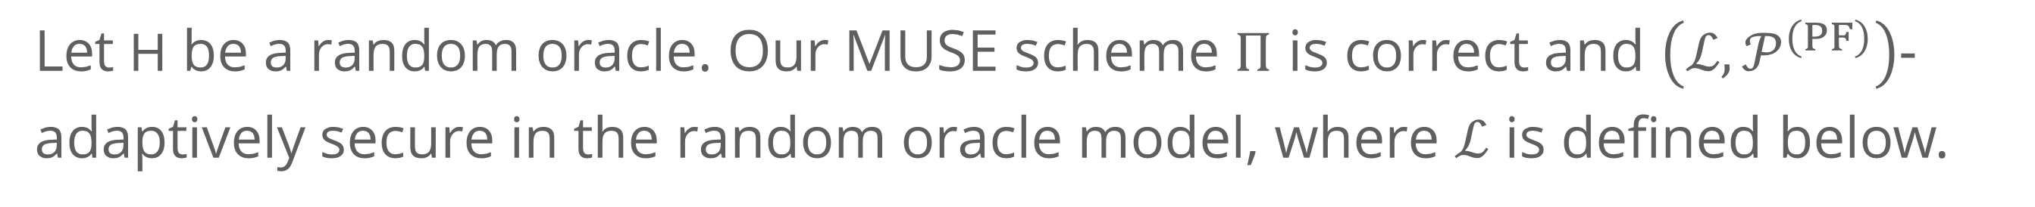
Our MUSE Construction: Security and Leakage Functions
Theorem
Let $\text{H}$ be a random oracle. Our MUSE scheme $Π$ is correct and $\left(ℒ,𝒫^{\left(PF\right)}\right)$-adaptively secure in the random oracle model, where $ℒ$ is defined below.
$ℒ_{Setup}\left(1^{κ},𝒫^{\left(PF\right)},𝒰\right)=\left({Λ,𝒫}^{\left(PF\right)},𝒰\right)$, where $Λ$ is a keyword universe
$ℒ_{KG}\left(\text{p}\right)=\left(p,{\text{TimeF}}_{p},{\text{Time}\text{W}}_{p}\right)$, where ${\text{TimeF}}_{p}$ and ${\text{Time}\text{W}}_{p}$ are decryption and search results
$ℒ_{Enc}\left(f_{id},𝒜\right)=\left\{\begin{aligned}\begin{matrix}\left(f_{id},𝒜\right) & \text{if} \text{kg} \text{query} \text{on} p \text{s}\text{.}\text{t}\text{. }P_{p}^{\left(PF\right)}\left(𝒜\right)=1 \text{exists}\end{matrix} \\ \begin{matrix}\left(\left|f_{id}\right|,𝒜\right) & \text{otherwise} \end{matrix}\end{aligned}\right.$
$ℒ_{Add}\left(\left(\text{i}\text{d},w\right),𝒜\right)=\left\{\begin{aligned}\begin{matrix}\left(\left(\text{id},w\right),𝒜\right) & \text{if} \text{kg} \text{query} \text{on} p \text{s}\text{.}\text{t}\text{. }P_{p}^{\left(PF\right)}\left(𝒜\right)=1 \text{and} \text{srch} \text{query} \text{on} w \text{exist}\end{matrix} \\ \begin{matrix}\left(\text{id},𝒜\right) & \text{otherwise} \end{matrix}\end{aligned}\right.$
$ℒ_{Srch}\left(q,p\right)=\left\{\begin{aligned}\begin{matrix}\left(p,q,{\text{SP}}_{q,p},{\text{A}\text{P}}_{q,p}\right) & \text{if} \text{srch} \text{query} \text{on} q \text{and} p \text{already} \text{exists}\end{matrix} \\ \begin{matrix}\left(p,{\text{SP}}_{q,p},{\text{AP}}_{q,p}\right) & \text{otherwise} \end{matrix}\end{aligned}\right.$
where ${\text{SP}}_{q,p}$ and ${\text{SP}}_{q,p}$ are search and access patterns

Slide 18
Concluding Remarks
Proposed a new MUSE scheme that supports prefix-fixing predicates
Constructed from only symmetric-key primitives
Provably secure in the random oracle model
Some open problems left
Support more flexible predicates (from symmetric-key primitives)
Achieve forward and backward privacy
Improve efficiency (e.g., by using public-key primitives to compress database size?)

Slide 19




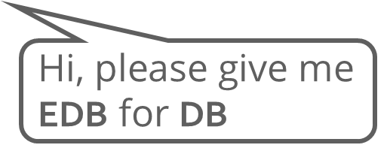
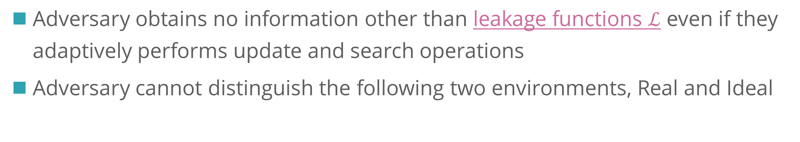
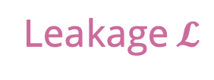
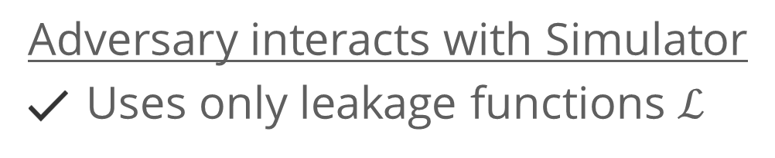







$\left(ℒ,𝒫\right)$-Adaptive Security: Definition Overview
Adversary obtains no information other than leakage functions $ℒ$ even if they adaptively performs update and search operations
Adversary cannot distinguish the following two environments, Real and Ideal
Adversary does not know which environments it is accessing to
Real
$$\text{DB}$$
Adversary interacts with DO
Runs algorithms as defined
Uses all info Client can use
$$\text{EDB}$$
Data Owner
$$\text{DB}$$
$$\text{EDB}$$
Ideal
Adversary interacts with Simulator
Uses only leakage functions $ℒ$
$$\text{DB}$$
$$\text{EDB}$$
Leakage $𝓛$
Hi, please give me $\text{ED}\text{B}$ for $\text{DB}$
$$\text{EDB}$$
Simulator

