Slide 1
IBE from Lattices with More Compactness in the Standard Model
Weidan Ji, Zhedong Wang, Haoxiang Jin, Geng Wang, Dawu Gu
Shanghai Jiao Tong University
Qi Wang
Heilongjiang University

Slide 2



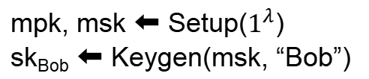
Identity-Based Encryption [Sha84]
“Bob”
mpk
sk_{Bob}
mpk, msk ⬅ Setup($1^{λ}$)
sk_{Bob} ⬅ Keygen(msk, “Bob”)
ct ⬅ Enc(mpk, “Bob”, msg)
msg ⬅ Dec(sk_{Bob}, ct)

Slide 3
IBE History
 | RO or Standard | Assumption
[BF01] | Random Oracle | Group
[Wat09] | Standard | Group
[GPV08] | Random Oracle | Lattice
[DLP14] | Random Oracle | Lattice + NTRU
[ABB10, Yam16, KY16, Yam17] | Standard | Lattice
This work | Standard | Lattice + NTRU
Our Goal: IBE with small-size public key in the standard model

Slide 4
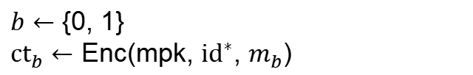


Selective IND-CPA Security Model
mpk, msk $←$ Setup($$1^{λ}$$)
$${id}^{∗}$$
Challenger
Adversary
mpk
sk_{i} $←$ Keygen(msk, ${id}_{i}$)
$${id}_{1}, {id}_{2}, ... , {id}_{Q}$$
$${sk}_{1}, {sk}_{2}, ... , {sk}_{Q}$$
$b←$ {0, 1}
${ct}_{b}$ $←$ Enc(mpk, ${id}^{∗}$, $m_{b}$)
$$m_{0}, m_{1}$$
$${ct}_{b}$$
$${id}_{1}, {id}_{2}, ... , {id}_{Q}$$
Output b’.
Adversary wins if $b=b’$.
$${sk}_{1}, {sk}_{2}, ... , {sk}_{Q}$$

Slide 5

Lattice
A lattice is the set of all integer linear combinations of (linearly independent) basis vectors $B=\{b_{1},...,b_{n}\}⊂ℝ^{n}$:
$$ℒ=\sum_{i=1}^{n}{b_{i}}∙ℤ=B∙ℤ^{n}$$

Slide 6
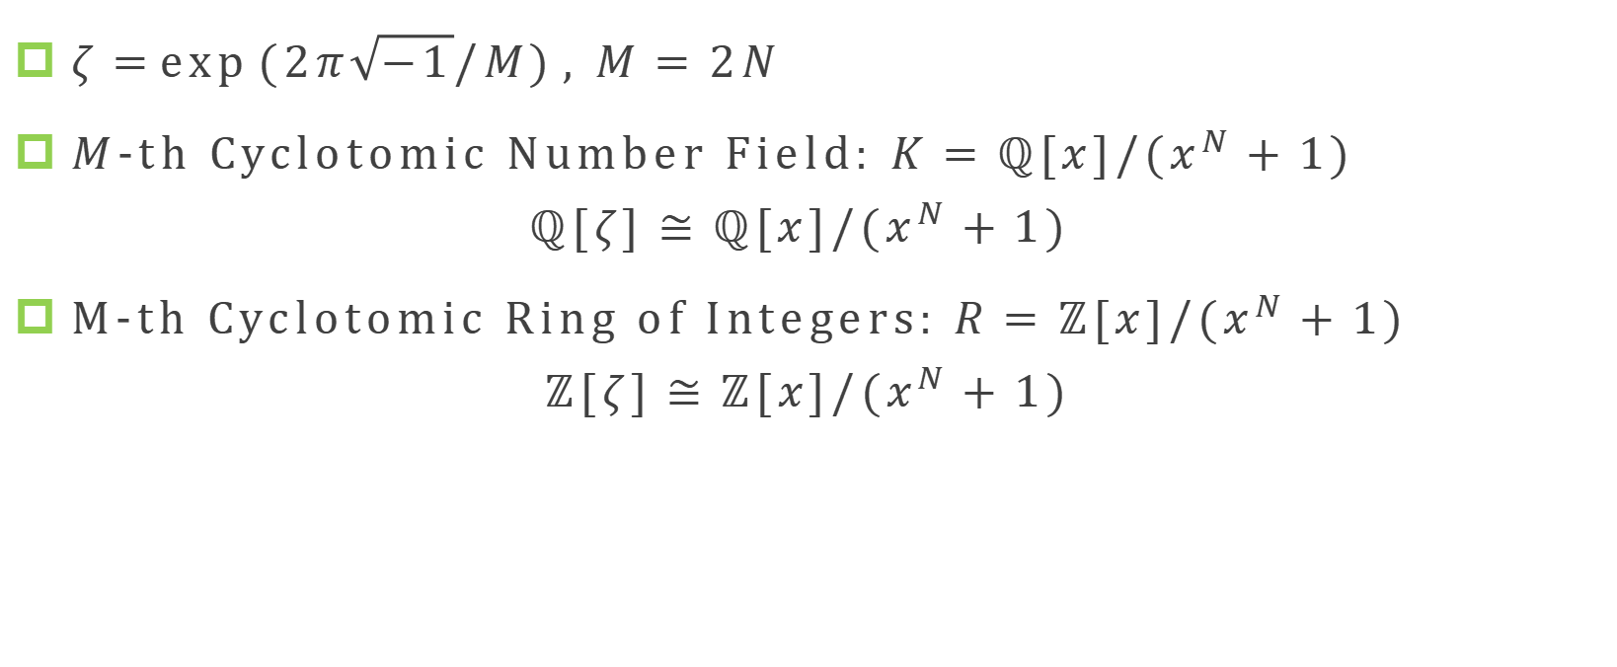
Algebra
$ζ=\exp{(2π\sqrt{−1}/M)}, M=2N$
$M$-th Cyclotomic Number Field: $K=ℚ[x]/(x^{N}+1)$
$$ℚ[ζ]≅ℚ[x]/(x^{N}+1)$$
M-th Cyclotomic Ring of Integers: $R=ℤ[x]/(x^{N}+1)$
$$ℤ[ζ]≅ℤ[x]/(x^{N}+1)$$

Slide 7
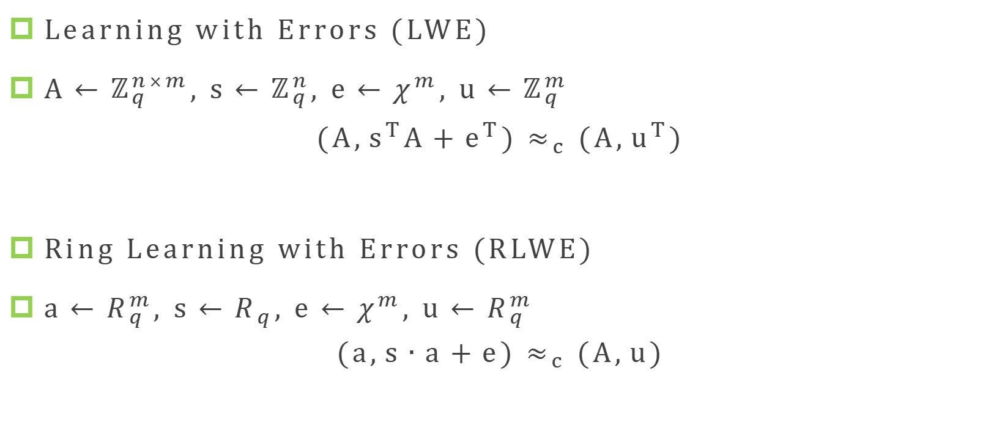
Learning with Errors (LWE) Assumption
Learning with Errors (LWE)
$A←ℤ_{q}^{n×m}, s←ℤ_{q}^{n}, e←χ^{m}, u←ℤ_{q}^{m}$
$$(A,s^{T}A+e^{T}) ≈_{c} (A,u^{T})$$
Ring Learning with Errors (RLWE)
$a←R_{q}^{m}, s←R_{q}, e←χ^{m}, u←R_{q}^{m}$
$$(a,s∙a+e) ≈_{c} (A,u)$$

Slide 8
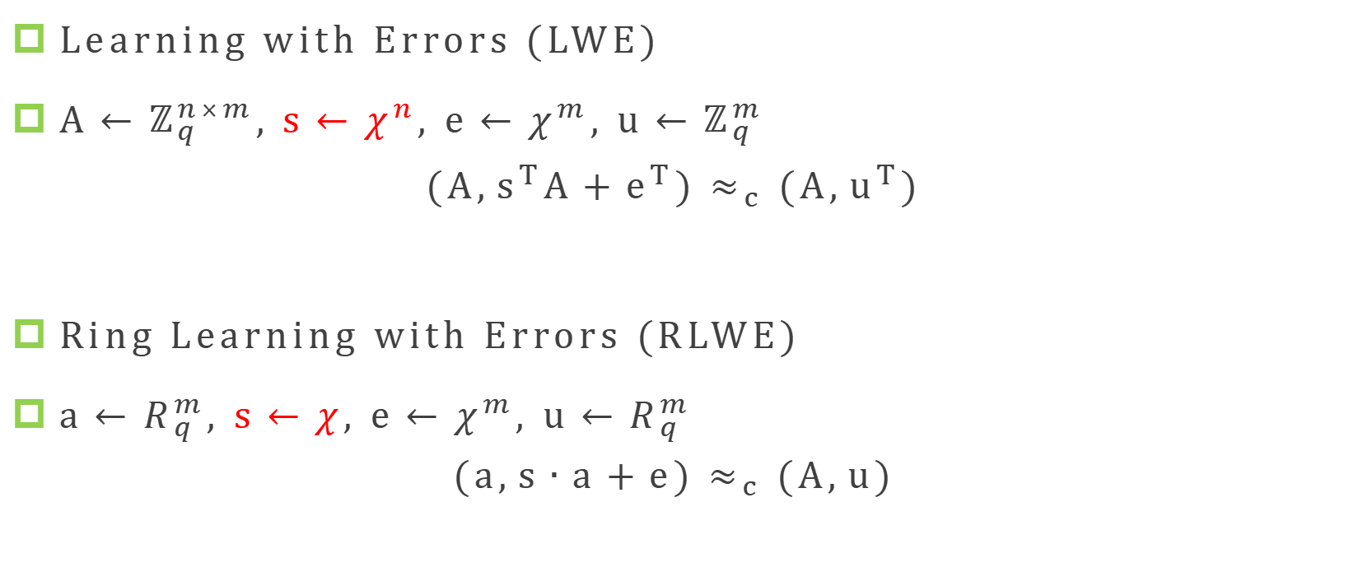
LWE in Hermite Normal Form [ACPS09]
Learning with Errors (LWE)
$A←ℤ_{q}^{n×m}, s←χ^{n}, e←χ^{m}, u←ℤ_{q}^{m}$
$$(A,s^{T}A+e^{T}) ≈_{c} (A,u^{T})$$
Ring Learning with Errors (RLWE)
$a←R_{q}^{m}, s←χ, e←χ^{m}, u←R_{q}^{m}$
$$(a,s∙a+e) ≈_{c} (A,u)$$

Slide 9
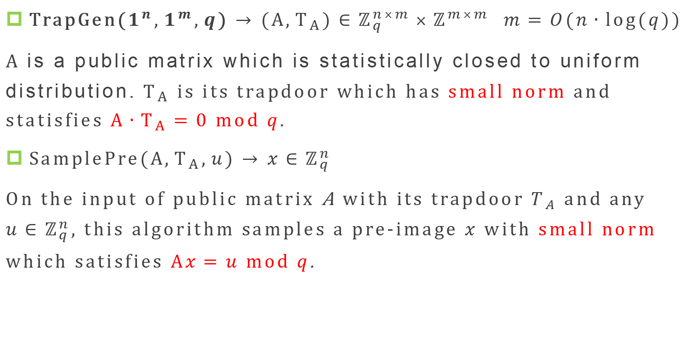
Ajtai Trapdoor [GPV08, MP12]
TrapGen($1^{n},1^{m},q$) $→$ $(A,T_{A})∈ℤ_{q}^{n×m}×ℤ^{m×m}$ $m=O(n∙log(q))$
A is a public matrix which is statistically closed to uniform distribution. $T_{A}$ is its trapdoor which has small norm and statisfies $A∙T_{A}=0 mod q$.
SamplePre($A,T_{A},u$) $→$ $x∈ℤ_{q}^{n}$
On the input of public matrix A with its trapdoor $T_{A}$ and any $u∈ℤ_{q}^{n}$, this algorithm samples a pre-image $x$ with small norm which satisfies $Ax=u mod q$.

Slide 10
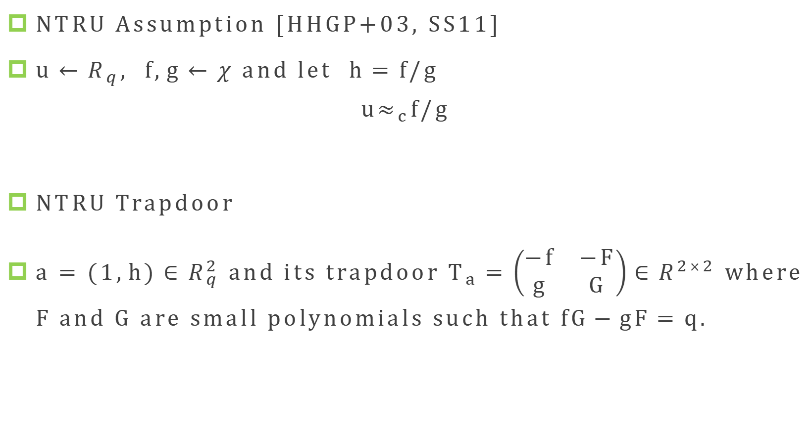
NTRU Assumption and NTRU Lattice
NTRU Assumption [HHGP+03, SS11]
$u←R_{q}, f,g←χ$ and let $h=f/g$
$$u≈_{c}f/g$$
NTRU Trapdoor
a = $(1,h)∈R_{q}^{2}$ and its trapdoor $T_{a}=\left(\begin{matrix}−f & −F \\ g & G\end{matrix}\right)∈R^{2×2}$ where F and G are small polynomials such that $fG−gF=q$.

Slide 11
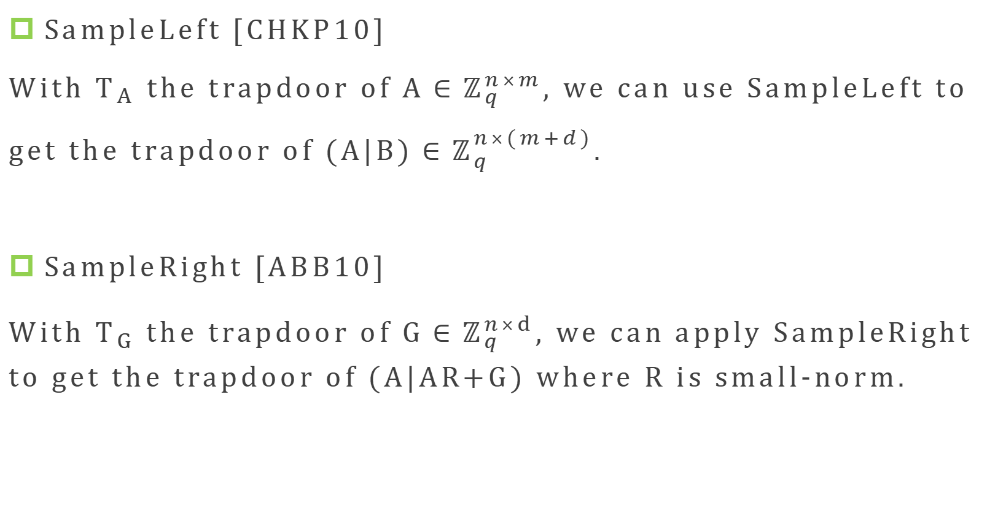
SampleLeft and SampleRight
SampleLeft [CHKP10]
With $T_{A}$ the trapdoor of $A∈ℤ_{q}^{n×m}$, we can use SampleLeft to get the trapdoor of $(A|B)∈ℤ_{q}^{n×(m+d)}$.
SampleRight [ABB10]
With $T_{G}$ the trapdoor of $G∈ℤ_{q}^{n×d}$, we can apply SampleRight to get the trapdoor of (A|AR+G) where R is small-norm.

Slide 12
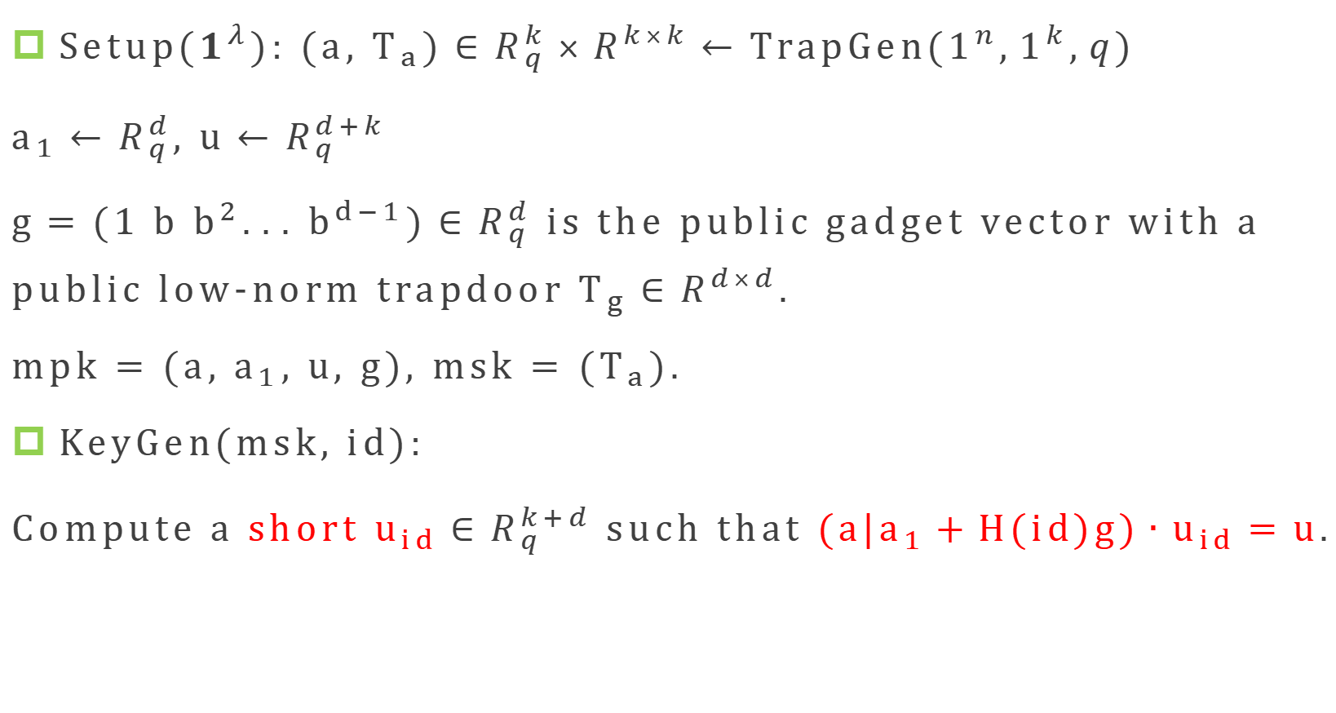
ABB10 IBE
Setup($1^{λ}$): $(a, T_{a})∈R_{q}^{k}×R^{k×k}←TrapGen(1^{n},1^{k},q)$
$a_{1}←R_{q}^{d}, u←R_{q}^{d+k}$
$g=(1 b b^{2}... b^{d−1})∈R_{q}^{d}$ is the public gadget vector with a public low-norm trapdoor $T_{g}∈R^{d×d}$.
mpk = (a, $a_{1}$, $u$, g), msk = ($T_{a}$).
KeyGen(msk, id):
Compute a short $u_{id}∈R_{q}^{k+d}$ such that $(a|a_{1}+H(id)g)∙u_{id}=u$.

Slide 13
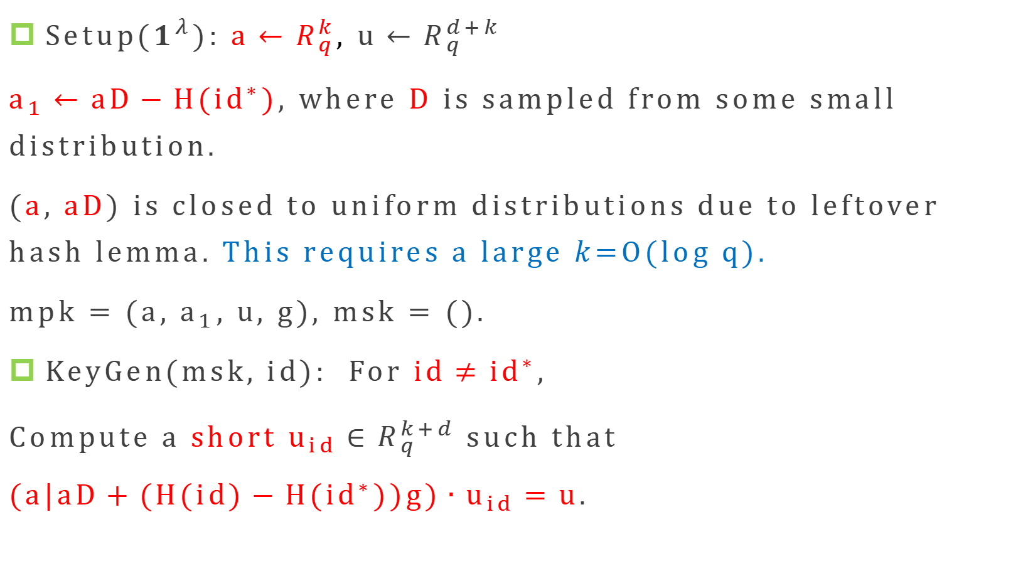
ABB10 IBE Hybrid Argument
Setup($1^{λ}$): $a←R_{q}^{k}, u←R_{q}^{d+k}$
$a_{1}←aD−H({id}^{∗}),$where D is sampled from some small distribution.
($a$,$aD$) is closed to uniform distributions due to leftover hash lemma. This requires a large $k$=O(log q).
mpk = (a, $a_{1}$, $u$, g), msk = ().
KeyGen(msk, id): For $id≠{id}^{∗}$,
Compute a short $u_{id}∈R_{q}^{k+d}$ such that
$(a|aD+(H(id)−H({id}^{∗}))g)∙u_{id}=u$.

Slide 14
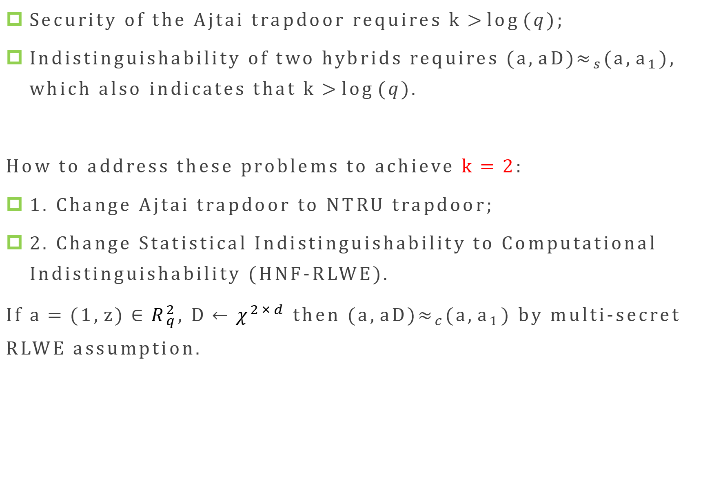
Restrictions on k
Security of the Ajtai trapdoor requires $k>\log{(q)}$;
Indistinguishability of two hybrids requires $(a,aD)≈_{s}(a,a_{1})$, which also indicates that $k>\log{(q)}$.
How to address these problems to achieve$k=2$:
1. Change Ajtai trapdoor to NTRU trapdoor;
2. Change Statistical Indistinguishability to Computational Indistinguishability (HNF-RLWE).
If $a=(1,z)∈R_{q}^{2}$, $D←χ^{2×d}$ then $(a,aD)≈_{c}(a,a_{1})$ by multi-secret RLWE assumption.

Slide 15
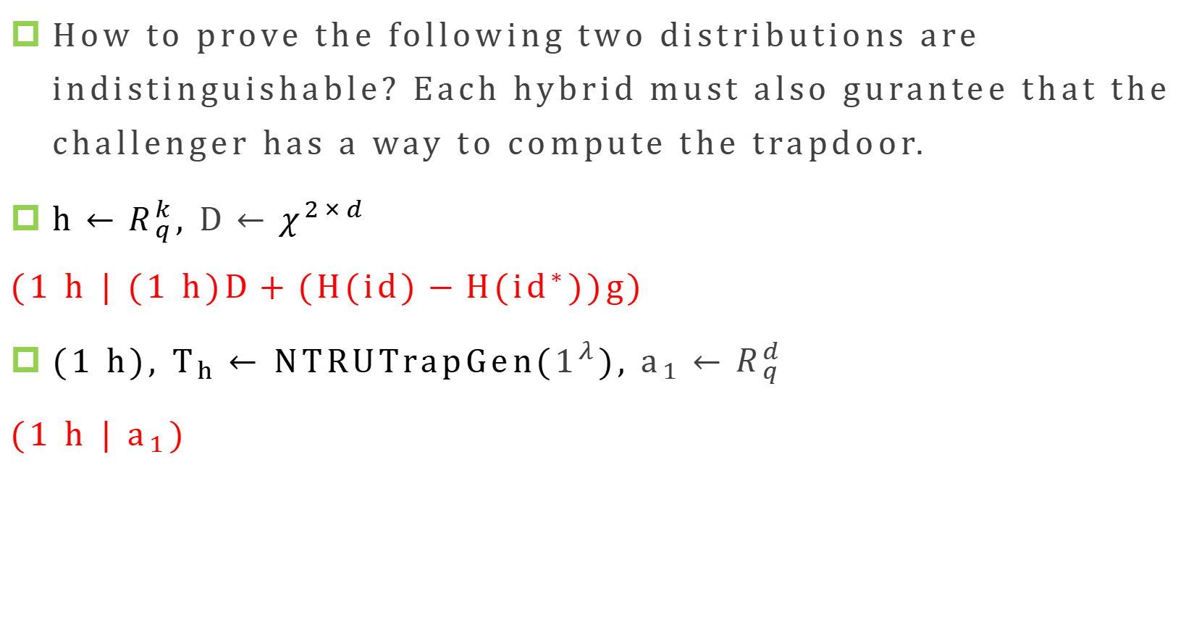
There still exists an issue:
How to prove the following two distributions are indistinguishable? Each hybrid must also gurantee that the challenger has a way to compute the trapdoor.
$h←R_{q}^{k}, D←χ^{2×d}$
$(1 h | (1 h)D+(H(id)−H({id}^{∗}))g)$
$(1 h), T_{h}←$ NTRUTrapGen($1^{λ}$), $a_{1}←R_{q}^{d}$
(1 h | $a_{1}$)

Slide 16
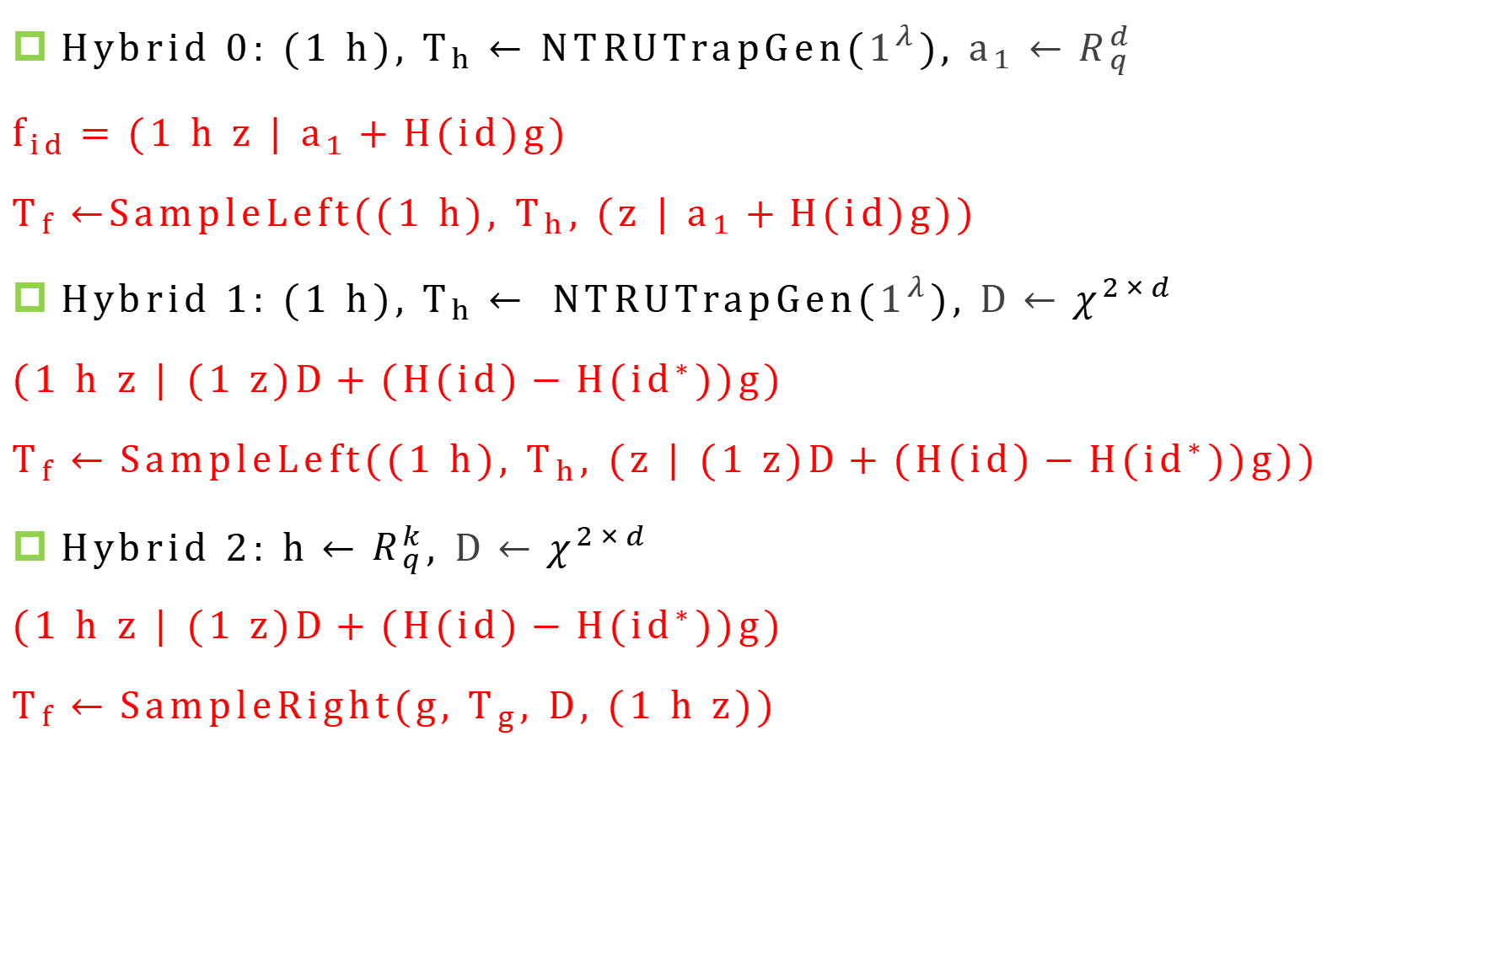
Our Approach
Hybrid 0:$(1 h), T_{h}←$ NTRUTrapGen($1^{λ}$), $a_{1}←R_{q}^{d}$
$f_{id}=(1 h z | a_{1}+H(id)g)$
$T_{f}←$SampleLeft((1 h), $T_{h}$, (z | $a_{1}+H(id)g$))
Hybrid 1: $(1 h), T_{h}← NTRUTrapGen(1^{λ}), D←χ^{2×d}$
$(1 h z | (1 z)D+(H(id)−H({id}^{∗}))g)$
$T_{f}←SampleLeft((1 h), T_{h}, (z | (1 z)D+(H(id)−H({id}^{∗}))g))$
Hybrid 2:$h←R_{q}^{k}, D←χ^{2×d}$
$(1 h z | (1 z)D+(H(id)−H({id}^{∗}))g)$
$T_{f}←SampleRight(g, T_{g}, D, (1 h z))$

Slide 17
THANK YOU
Q & A

