Slide 1

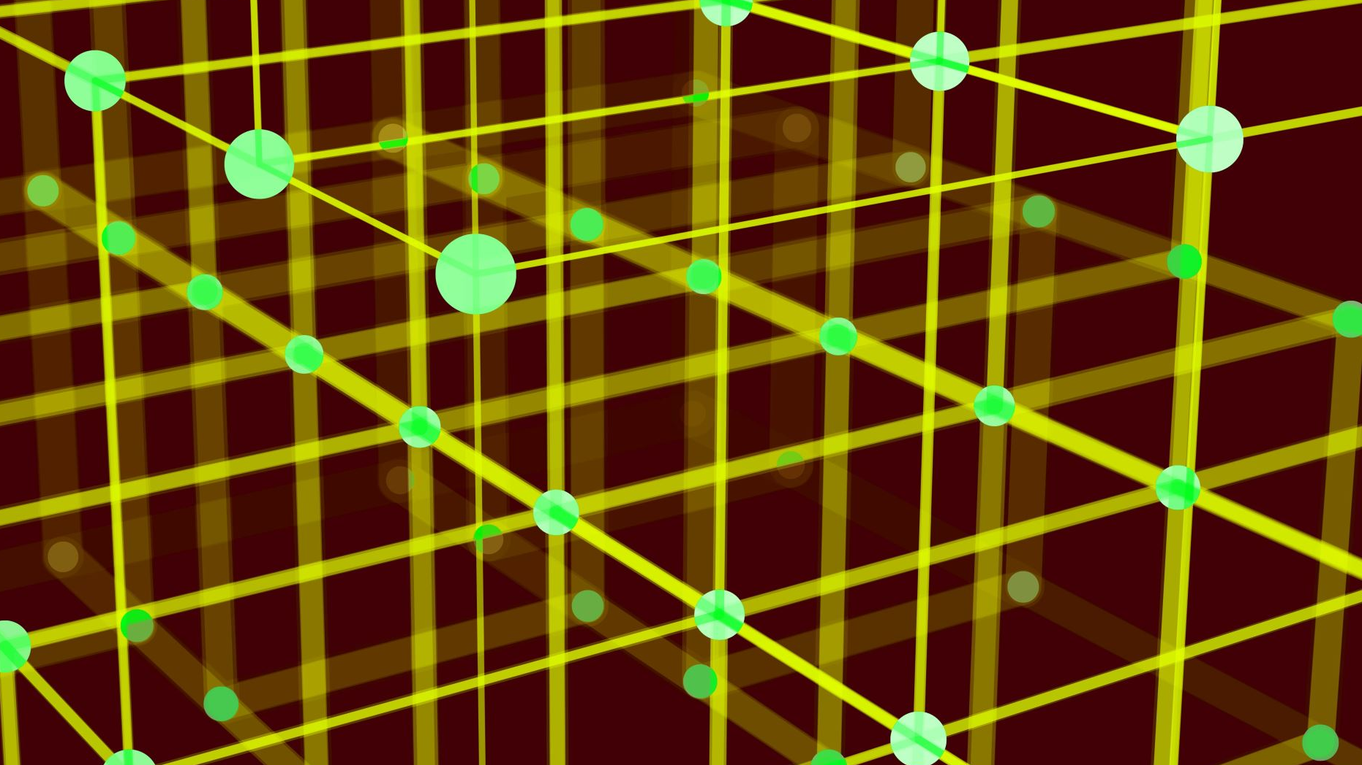


Provable Decryption Failure Security for
Practical Lattice-based PKE
Christian Majenz, Fabrizio Sisinni

Slide 2
Motivations
The Fujisaki-Okamoto (FO) transform is the standard way to build secure Key Encapsulation Mechanisms (KEMs).
Lattice-based cryptography dominates Post-Quantum Cryptography (PQC); for efficiency reasons, such schemes are not perfectly correct.
Dealing with decryption failures is central for both concrete and provable security.
Tighter bounds in the Quantum Random Oracle Model (QROM) often come at the cost of additional requirements.
Some requirements related to decryption failures must be verified for each concrete Public-Key Encryption (PKE) scheme.

Slide 3
Our Contributions
  We extend the analysis in [MajSis24] to the Ring-LWE and Module-LWE problem using the Dual Regev scheme [GPV08] as underlying PKE scheme.
  We define a new family of subgaussian distributions that includes both discrete Gaussians and centered binomials, among others.
[MajSis24] C. Majenz, and F. Sisinni. Provable security against decryption failure attacks from LWE
[GPV08] C. Gentry, C. Peikert, V. Vaikuntanathan. How to Use a Short Basis: Trapdoors for Hard Lattices and New Cryptographic Constructions

Slide 4
Outline
Find Failing Plaintext – Non-Generic (FFP-NG)
The Ring Learning With Errors (RLWE) Problem
Subgaussian Probability Distributions
Security Reduction from RLWE to FFP-NG
Open Problems

Slide 5
The Ring Learning With Errors problem
The Ring Learning With Errors (RLWE) Problem
Find Failing Plaintext – Non-Generic (FFP-NG)
Subgaussian Probability Distributions
The Decisional RLWE Problem
Security Reduction from RLWE to FFP-NG
The LPR PKE scheme
Open Problems

Slide 6
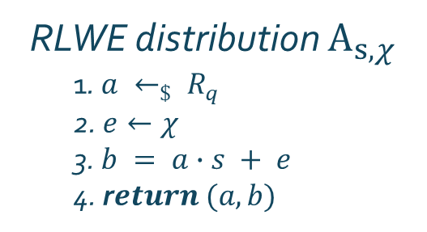
The Decisional RLWE Problem
The RLWE problem [LPR10] is the extension to rings of the LWE problem over integers, introduced in [Regev09]. Let $R= ℤ[X]/\left\langle X^{n}+1\right\rangle$ be a ring, $q$ an odd prime, χ a distribution over $R_{q}$, and $s⟵χ$ a secret element.
RLWE distribution $A_{s, χ}$
1. $a ←_{\$} R_{q}$
2. $e←χ$
3. $b = a∙s + e$
4. r$eturn (a, b)$
[LPR10] V. Lyubashevsky, C. Peikert, and O. Regev. On ideal lattices and learning with errors over rings.
[Regev09] O. Regev. On Lattices, Learning with Errors, Random Linear Codes, and Cryptography.

Slide 7



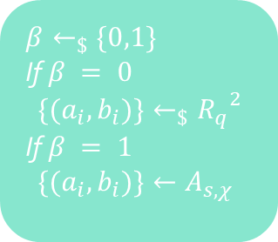
The Decisional RLWE Problem
The RLWE problem [LPR10] is the extension to rings of the LWE problem over integers, introduced in [Regev09]. Let $R= ℤ[X]/\left\langle X^{n}+1\right\rangle$ be a ring, $q$ an odd prime, χ a distribution over $R_{q}$, and $s⟵χ$ a secret element.
$$\{(a_{i}, b_{i})\}$$
RLWE distribution $A_{s, χ}$
1. $a ←_{\$} R_{q}$
2. $e←χ$
3. $b = a∙s + e$
4. r$eturn (a, b)$
$$β^{′}$$
$$⟦β = β′⟧$$
$$β←_{\$}\{0,1\}$$
If $β = 0$
$\{(a_{i}, b_{i})\}←_{\$}{R_{q}}^{2}$
If $β = 1$
$\{(a_{i}, b_{i})\}←A_{s, χ}$
[LPR10] V. Lyubashevsky, C. Peikert, and O. Regev. On ideal lattices and learning with errors over rings.
[Regev09] O. Regev. On Lattices, Learning with Errors, Random Linear Codes, and Cryptography.

Slide 8
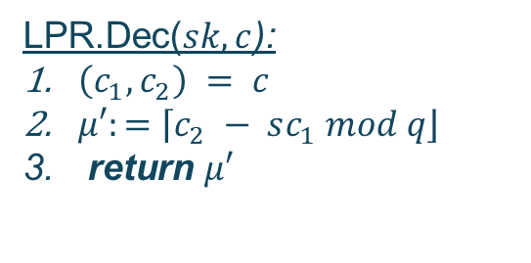



The LPR PKE Scheme
We use as underlying PKE scheme the one introduced in [LPR10]. Let $q$ be an odd prime, $n$ a power of $2$, $R= ℤ[X]/\left\langle X^{n}+1\right\rangle$, χ a distribution over $R_{q}$, and $s ←χ$ a secret element.
The message space is $R_{2}$ and the challenge space is $R_{q}×R_{q}$.
LPR.KeyGen():
$a←_{\$}R_{q}$
$s,e ← χ_{σ}$
$b≔as+e$
$sk≔s$, $pk≔(a,b)$
return $(pk,sk)$
LPR.Enc($pk,μ$):
$r, e_{1}, e_{2}←χ$
$c_{1}≔ar+e_{1} mod q$
$c_{2}≔br+e_{2}+\left\lceil \left.μ\right\rfloor \right. mod q$
$c:=\left(c_{1},c_{2}\right)$
return $(pk,sk)$
LPR.Dec($sk,c$):
$\left(c_{1},c_{2}\right) = c$
$μ′:=\left\lceil \left.c_{2} − sc_{1} mod q\right\rfloor \right.$
return $μ′$
[LPR10] V. Lyubashevsky, C. Peikert, and O. Regev. On ideal lattices and learning with errors over rings.

Slide 9

Decryption Failure Condition
Given a ciphertext $c←LPR.Enc\left(pk, μ\right)$, the decryption algorithm computes
$$\left\lceil \left.c_{2} − sc_{1} mod q\right\rfloor \right. =\left\lceil \left.br+e_{2}+\left\lceil \left.μ\right\rfloor \right.− s\left(ar+e_{1}\right) mod q\right\rfloor \right.$$
$=\left\lceil \left.er−se_{1}+e_{2}+\left\lceil \left.μ\right\rfloor \right. mod q\right\rfloor \right.$
Let $z≔er−se_{1}+e_{2}$ the total error gained during decryption and let $w^{⊺}≔\left[r^{⊺}, {e_{1}}^{⊺}\right]$, $v^{⊺}≔\left[e^{⊺}, −s^{⊺}\right]$ be the combined coefficient vectors. We can write the $k$-th coordinate of $z$ as
$$\left\langle v, w_{\left(k\right)}\right\rangle +e_{2}\left[k\right].$$

Slide 10
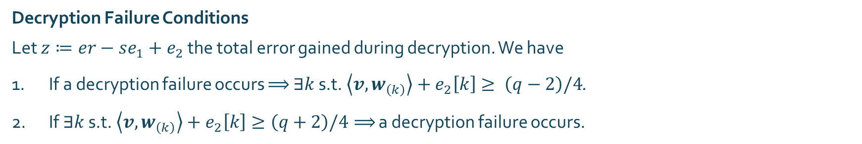
Decryption Failure Condition
Given a ciphertext $c←LPR.Enc\left(pk, μ\right)$, the decryption algorithm computes
$$\left\lceil \left.c_{2} − sc_{1} mod q\right\rfloor \right. =\left\lceil \left.br+e_{2}+\left\lceil \left.μ\right\rfloor \right.− s\left(ar+e_{1}\right) mod q\right\rfloor \right.$$
$=\left\lceil \left.er−se_{1}+e_{2}+\left\lceil \left.μ\right\rfloor \right. mod q\right\rfloor \right.$
Let $z≔er−se_{1}+e_{2}$ the total error gained during decryption and let $w^{⊺}≔\left[r^{⊺}, {e_{1}}^{⊺}\right]$, $v^{⊺}≔\left[e^{⊺}, −s^{⊺}\right]$ be the combined coefficient vectors. We can write the $k$-th coordinate of $z$ as
$$\left\langle v, w_{\left(k\right)}\right\rangle +e_{2}\left[k\right].$$
Decryption Failure Conditions
Let $z≔er−se_{1}+e_{2}$ the total error gained during decryption. We have
If a decryption failure occurs $⟹$ $∃k$ s.t. $\left\langle v, w_{\left(k\right)}\right\rangle +e_{2}\left[k\right]≥ \left(q−2\right)/4$.
If $∃k$ s.t. $\left\langle v, w_{\left(k\right)}\right\rangle +e_{2}\left[k\right]≥\left(q+2\right)/4⟹$ a decryption failure occurs.

Slide 11

Decryption Failure Condition
Let $z∈R$, we define its $k$-th rotation as
$$z_{\left(k\right)} := X^{k}z\left(X^{−1}\right).$$
Let $w^{⊺}≔\left[r^{⊺}, {e_{1}}^{⊺}\right]$, $v^{⊺}≔\left[e^{⊺}, −s^{⊺}\right]$ be the concatenation of coefficient vectors. We can write the $k$-th coordinate of the total decryption error as
$$\left\langle v, w_{\left(k\right)}\right\rangle +e_{2}\left[k\right].$$

Slide 12
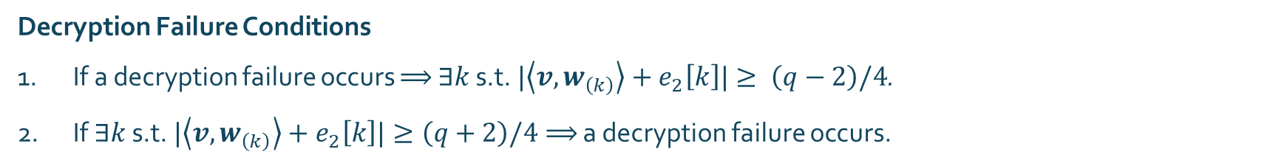
Decryption Failure Condition
Let $z∈R$, we define its $k$-th rotation as
$$z_{\left(k\right)} := X^{k}z\left(X^{−1}\right).$$
Let $w^{⊺}≔\left[r^{⊺}, {e_{1}}^{⊺}\right]$, $v^{⊺}≔\left[e^{⊺}, −s^{⊺}\right]$ be the concatenation of coefficient vectors. We can write the $k$-th coordinate of the total decryption error as
$$\left\langle v, w_{\left(k\right)}\right\rangle +e_{2}\left[k\right].$$
Decryption Failure Conditions
If a decryption failure occurs $⟹$ $∃k$ s.t. $|\left\langle v, w_{\left(k\right)}\right\rangle +e_{2}\left[k\right]|≥ \left(q−2\right)/4$.
If $∃k$ s.t. $|\left\langle v, w_{\left(k\right)}\right\rangle +e_{2}\left[k\right]|≥\left(q+2\right)/4⟹$ a decryption failure occurs.

Slide 13
Subgaussian Probability Distributions
Subgaussian Probability Distributions
Find Failing Plaintext – Non-Generic (FFP-NG)
The Ring Learning With Errors (RLWE) problem
Gaussian-like Tail Decay
Security Reduction from RLWE to FFP-NG
New Class of Subgaussians
Open Problems

Slide 14

Gaussian-like Tail Decay
A subgaussian with parameter σ is a family of probability distributions with mean $0$ and tail decay bounded by a Gaussian with standard deviation σ.

Slide 15

Gaussian-like Tail Decay
A subgaussian with parameter σ is a family of probability distributions with mean $0$ and tail decay bounded by a Gaussian with standard deviation σ.
This family contains a wide range of distributions such as:
Gaussians;
Centered binomials;
Centered and bounded.

Slide 16

Gaussian-like Tail Decay
A subgaussian with parameter σ is a family of probability distributions with mean $0$ and tail decay bounded by a Gaussian with standard deviation σ.
This family contains a wide range of distributions such as:
Gaussians;
Centered binomials;
Centered and bounded.
We have no control over the behavior around the mean.

Slide 17

New Class of Subgaussians
Continuous Gaussians
Let $X←𝒩(0,{σ_{x}}^{2})$ and $Y←𝒩(0,{σ_{y}}^{2})$ be two independent samples and let $Z ≔X+Y$ .
We know that
$Z←𝒩(0,{σ_{z}}^{2})$ , where ${σ_{z}}^{2}={σ_{x}}^{2}+{σ_{y}}^{2}$;
The conditional distribution
$X|Z=z←𝒩\left(z\frac{{σ_{x}}^{2}}{{σ_{z}}^{2}} , \frac{{σ_{x}}^{2}{σ_{y}}^{2}}{{σ_{z}}^{2}}\right)$.

Slide 18

New Class of Subgaussians
Continuous Gaussians
New Family of Subgaussians
Let $X←𝒩(0,{σ_{x}}^{2})$ and $Y←𝒩(0,{σ_{y}}^{2})$ be two independent samples and let $Z ≔X+Y$ .
We know that
$Z←𝒩(0,{σ_{z}}^{2})$ , where ${σ_{z}}^{2}={σ_{x}}^{2}+{σ_{y}}^{2}$;
The conditional distribution
$X|Z=z←𝒩\left(z\frac{{σ_{x}}^{2}}{{σ_{z}}^{2}} , \frac{{σ_{x}}^{2}{σ_{y}}^{2}}{{σ_{z}}^{2}}\right)$.
Let $X$ and $Y$ be two independent subgaussians with parameter $σ_{x}$ and $σ_{y}$ respectively and let
$Z≔X+Y$ be a subgaussian with parameter $σ_{z}$ .
There exists a distribution$𝒲_{z}$ such that
$𝒲_{z}$ is subgaussian with parameter
$σ_{w}≤\frac{σ_{x}σ_{y}}{σ_{z}}$;
The distribution of $X|Z=z$ and$𝒲_{z}+z\frac{{σ_{x}}^{2}}{{σ_{z}}^{2}}$ are within negligible statistical distance.

Slide 19
Find Failing Plaintext – Non-Generic
Find Failing Plaintext – Non-Generic (FFP-NG)
The Ring Learning With Errors (RLWE) Problem
Subgaussian Probability Distributions
The FFP-NG Game
Security Reduction from RLWE to FFP-NG
Possible Winning Strategies
Open Problems

Slide 20

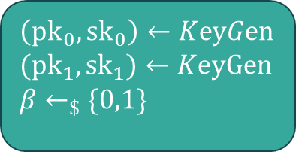





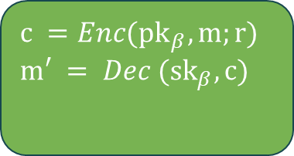
The FFP-NG Game
This game was introduced in [HHM22] to bound the adversary’s advantage in obtaining information about a key pair by triggering a decryption failure.
$${pk}_{0}$$
$$(m,r)$$
$$β^{′}$$
$$⟦β = β′⟧$$
$$⟦m ≠ m′⟧$$
$${FCO}_{β}$$
$$\left({pk}_{0},{sk}_{0}\right)←KeyGen$$
$$({pk}_{1}, {sk}_{1})←KeyGen$$
$$β←_{\$}\{0,1\}$$
$$c =Enc({pk}_{β},m;r)$$
$$m′ = Dec ({sk}_{β}, c)$$
[HHM22] K. Hövelmanns, A. Hülsing, and C. Majenz. Failing gracefully: Decryption failures and the Fujisaki-Okamoto transform.

Slide 21
Possible Winning Strategies
When dealing with non-perfectly correct PKE scheme, an FFP-NG adversary has limited options to gain a non-negligible advantage in winning the game.

Slide 22
Possible Winning Strategies
When dealing with non-perfectly correct PKE scheme, an FFP-NG adversary has limited options to gain a non-negligible advantage in winning the game.
Key dependency
To gain any advantage, the adversary must always use the given public key to choose the message–randomness pair used to query the oracle.

Slide 23
Possible Winning Strategies
When dealing with non-perfectly correct PKE scheme, an FFP-NG adversary has limited options to gain a non-negligible advantage in winning the game.
Key dependency
To gain any advantage, the adversary must always use the given public key to choose the message–randomness pair used to query the oracle.
Trigger decryption failure
To gain a non-negligible advantage, the adversary must trigger a decryption failure with respect to the given public key using the message-randomness pair.

Slide 24
Security Reduction from RLWE to
FFP-NG
Security Reduction from RLWE to FFP-NG
Find Failing Plaintext – Non-Generic (FFP-NG)
The Ring Learning With Errors (RLWE) problem
Main Result
Subgaussian Probability Distributions
The RLWE Adversary
Open Problems

Slide 25
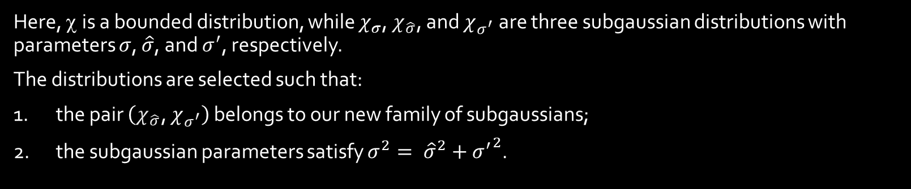
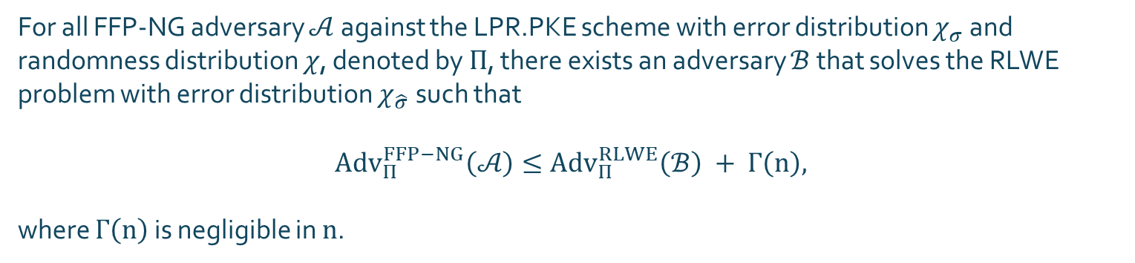
Main Result
For all FFP-NG adversary $𝒜$ against the LPR.PKE scheme with error distribution $χ_{σ}$ and randomness distribution $χ$, denoted by $Π$, there exists an adversary $ℬ$ that solves the RLWE problem with error distribution $χ_{\hat{σ}}$ such that
$${Adv}_{Π}^{FFP−NG}\left(𝒜\right)≤{Adv}_{Π}^{RLWE}\left(ℬ\right) + Γ\left(n\right),$$
where $Γ\left(n\right)$ is negligible in $n$.
Here, χ is a bounded distribution, while $χ_{σ}$, $χ_{\hat{σ}}$, and $χ_{σ^{′}}$ are three subgaussian distributions with parameters $σ$, $\hat{σ}$, and $σ^{′}$, respectively.
The distributions are selected such that:
the pair $\left(χ_{\hat{σ}}\text{, }χ_{σ^{′}}\right)$ belongs to our new family of subgaussians;
the subgaussian parameters satisfy $σ^{2}= {\hat{σ}}^{2}+{σ^{′}}^{2}$.

Slide 26
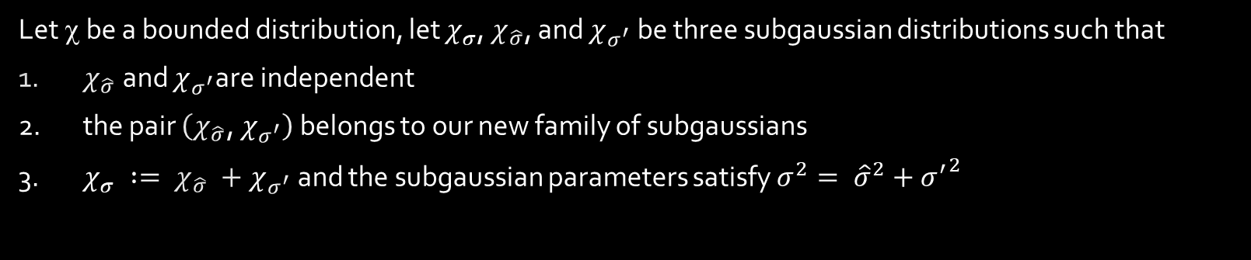
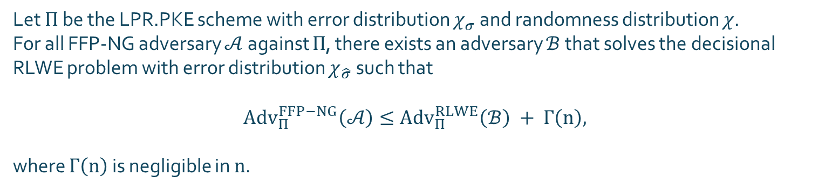
Main Result
Let χ be a bounded distribution, let $χ_{σ}$, $χ_{\hat{σ}}$, and $χ_{σ^{′}}$ be three subgaussian distributions such that
$χ_{\hat{σ}}$and $χ_{σ^{′}}$are independent
the pair $\left(χ_{\hat{σ}}\text{, }χ_{σ^{′}}\right)$ belongs to our new family of subgaussians
$χ_{σ} := χ_{\hat{σ}} +χ_{σ^{′}}$and the subgaussian parameters satisfy $σ^{2}= {\hat{σ}}^{2}+{σ^{′}}^{2}$
Let $Π$ be the LPR.PKE scheme with error distribution $χ_{σ}$ and randomness distribution $χ$.
For all FFP-NG adversary $𝒜$ against $Π$, there exists an adversary $ℬ$ that solves the decisional RLWE problem with error distribution $χ_{\hat{σ}}$ such that
$${Adv}_{Π}^{FFP−NG}\left(𝒜\right)≤{Adv}_{Π}^{RLWE}\left(ℬ\right) + Γ\left(n\right),$$
where $Γ\left(n\right)$ is negligible in $n$.

Slide 27

The RLWE Adversary
$$ℬ\left(a, b\right):$$
$s^{′},e^{′}←χ_{σ^{′}}$
$b^{′}≔as^{′}+e^{′}$
${pk}^{′}≔\left(a,b+b^{′}\right)$
$\left(μ, \left(r, e_{1}, e_{2}\right)\right)←𝒜\left({pk}^{′}\right)$
$w^{⊺}≔\left[r^{⊺}, {e_{1}}^{⊺}\right]$, ${v^{′}}^{⊺}≔\left[{e^{′}}^{⊺}, −{s^{′}}^{⊺}\right]$
$θ≔θ\left(n,\left\|w\right\|\right)$
if $∃k$ s.t. $\left|\left\langle v^{′}, w_{\left(k\right)}\right\rangle +e_{2}\left[k\right]\right|≥\frac{q−2}{4}−θ$
return $1$
else
return $0$
The RLWE adversary samples two errors from a quite small distribution.

Slide 28
The RLWE Adversary
$$ℬ\left(a, b\right):$$
$s^{′},e^{′}←χ_{σ^{′}}$
$b^{′}≔as^{′}+e^{′}$
${pk}^{′}≔\left(a,b+b^{′}\right)$
$\left(μ, \left(r, e_{1}, e_{2}\right)\right)←𝒜\left({pk}^{′}\right)$
$w^{⊺}≔\left[r^{⊺}, {e_{1}}^{⊺}\right]$, ${v^{′}}^{⊺}≔\left[{e^{′}}^{⊺}, −{s^{′}}^{⊺}\right]$
$θ≔θ\left(n,\left\|w\right\|\right)$
if $∃k$ s.t. $\left|\left\langle v^{′}, w_{\left(k\right)}\right\rangle +e_{2}\left[k\right]\right|≥\frac{q−2}{4}−θ$
return $1$
else
return $0$
They use the extra errors to tweak the given sample.

Slide 29

The RLWE Adversary
$$ℬ\left(a, b\right):$$
$s^{′},e^{′}←χ_{σ^{′}}$
$b^{′}≔as^{′}+e^{′}$
${pk}^{′}≔\left(a,b+b^{′}\right)$
$\left(μ, \left(r, e_{1}, e_{2}\right)\right)←𝒜\left({pk}^{′}\right)$
$w^{⊺}≔\left[r^{⊺}, {e_{1}}^{⊺}\right]$, ${v^{′}}^{⊺}≔\left[{e^{′}}^{⊺}, −{s^{′}}^{⊺}\right]$
$θ≔θ\left(n,\left\|w\right\|\right)$
if $∃k$ s.t. $\left|\left\langle v^{′}, w_{\left(k\right)}\right\rangle +e_{2}\left[k\right]\right|≥\frac{q−2}{4}−θ$
return $1$
else
return $0$
They use the extra errors to tweak the given sample.
If $\left(a, b\right)←_{\$}R_{q}×R_{q}$, also ${pk}^{′} ←_{\$}$ $R_{q}×R_{q}$.
If $\left(a, b\right)←A_{s,χ_{\hat{σ}}}$, we have $b≔a\hat{s}+\hat{e}$ with $\hat{s},\hat{e}⟵χ_{\hat{σ}}$ .
This means that
$b^{′}+ b≔a\left(s^{′}+\hat{s}\right)+$ $\left(e^{′}+\hat{e}\right)$,
where $s=\left(s^{′}+\hat{s}\right)$ and $e=\left(e^{′}+\hat{e}\right)$ are distributed according to $χ_{σ}$.

Slide 30
The RLWE Adversary
$$ℬ\left(a, b\right):$$
$s^{′},e^{′}←χ_{σ^{′}}$
$b^{′}≔as^{′}+e^{′}$
${pk}^{′}≔\left(a,b+b^{′}\right)$
$\left(μ, \left(r, e_{1}, e_{2}\right)\right)←𝒜\left({pk}^{′}\right)$
$w^{⊺}≔\left[r^{⊺}, {e_{1}}^{⊺}\right]$, ${v^{′}}^{⊺}≔\left[{e^{′}}^{⊺}, −{s^{′}}^{⊺}\right]$
$θ≔θ\left(n,\left\|w\right\|\right)$
if $∃k$ s.t. $\left|\left\langle v^{′}, w_{\left(k\right)}\right\rangle +e_{2}\left[k\right]\right|≥\frac{q−2}{4}−θ$
return $1$
else
return $0$
They call the FFP-NG adversary using the tweaked public key.

Slide 31
The RLWE Adversary
$$ℬ\left(a, b\right):$$
$s^{′},e^{′}←χ_{σ^{′}}$
$b^{′}≔as^{′}+e^{′}$
${pk}^{′}≔\left(a,b+b^{′}\right)$
$\left(μ, \left(r, e_{1}, e_{2}\right)\right)←𝒜\left({pk}^{′}\right)$
$w^{⊺}≔\left[r^{⊺}, {e_{1}}^{⊺}\right]$, ${v^{′}}^{⊺}≔\left[{e^{′}}^{⊺}, −{s^{′}}^{⊺}\right]$
$θ≔θ\left(n,\left\|w\right\|\right)$
if $∃k$ s.t. $\left|\left\langle v^{′}, w_{\left(k\right)}\right\rangle +e_{2}\left[k\right]\right|≥\frac{q−2}{4}−θ$
return $1$
else
return $0$
According to the randomness used to query the FCO, the RLWE adversary defines a threshold.

Slide 32

The RLWE Adversary
$$ℬ\left(a, b\right):$$
$s^{′},e^{′}←χ_{σ^{′}}$
$b^{′}≔as^{′}+e^{′}$
${pk}^{′}≔\left(a,b+b^{′}\right)$
$\left(μ, \left(r, e_{1}, e_{2}\right)\right)←𝒜\left({pk}^{′}\right)$
$w^{⊺}≔\left[r^{⊺}, {e_{1}}^{⊺}\right]$, ${v^{′}}^{⊺}≔\left[{e^{′}}^{⊺}, −{s^{′}}^{⊺}\right]$
$θ≔θ\left(n,\left\|w\right\|\right)$
if $∃k$ s.t. $\left|\left\langle v^{′}, w_{\left(k\right)}\right\rangle +e_{2}\left[k\right]\right|≥\frac{q−2}{4}−θ$
return $1$
else
return $0$
They exploit the known errors $\left(s^{′},e^{′}\right)$ to test the adversary’s randomness $\left(r, e_{1}, e_{2}\right)$ against a shifted decryption failure threshold.

Slide 33
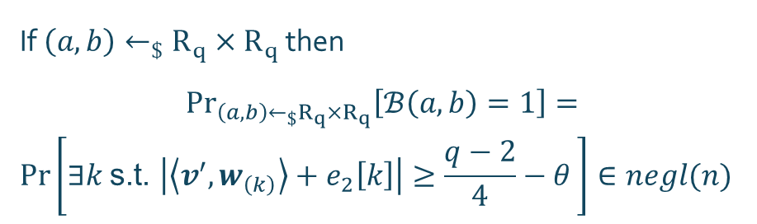
The RLWE Adversary
$$ℬ\left(a, b\right):$$
$s^{′},e^{′}←χ_{σ^{′}}$
$b^{′}≔as^{′}+e^{′}$
${pk}^{′}≔\left(a,b+b^{′}\right)$
$\left(μ, \left(r, e_{1}, e_{2}\right)\right)←𝒜\left({pk}^{′}\right)$
$w^{⊺}≔\left[r^{⊺}, {e_{1}}^{⊺}\right]$, ${v^{′}}^{⊺}≔\left[{e^{′}}^{⊺}, −{s^{′}}^{⊺}\right]$
$θ≔θ\left(n,\left\|w\right\|\right)$
if $∃k$ s.t. $\left|\left\langle v^{′}, w_{\left(k\right)}\right\rangle +e_{2}\left[k\right]\right|≥\frac{q−2}{4}−θ$
return $1$
else
return $0$
In high dimensions, random vectors tend to be orthogonal. This makes it unlikely to pass the test with a random public key.
If $\left(a, b\right)←_{\$}R_{q}×R_{q}$ then
$${Pr}_{\left(a, b\right)←_{\$}R_{q}×R_{q}}\left[ℬ\left(a, b\right)=1\right]=$$
$$Pr\left[∃k \text{s.t. }\left|\left\langle v^{′}, w_{\left(k\right)}\right\rangle +e_{2}\left[k\right]\right|≥\frac{q−2}{4}−θ \right]∈negl(n)$$

Slide 34

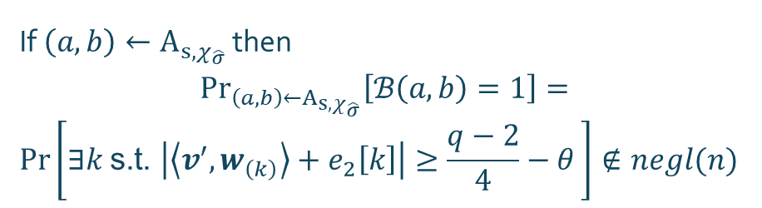
The RLWE Adversary
$$ℬ\left(a, b\right):$$
$s^{′},e^{′}←χ_{σ^{′}}$
$b^{′}≔as^{′}+e^{′}$
${pk}^{′}≔\left(a,b+b^{′}\right)$
$\left(μ, \left(r, e_{1}, e_{2}\right)\right)←𝒜\left({pk}^{′}\right)$
$w^{⊺}≔\left[r^{⊺}, {e_{1}}^{⊺}\right]$, ${v^{′}}^{⊺}≔\left[{e^{′}}^{⊺}, −{s^{′}}^{⊺}\right]$
$θ≔θ\left(n,\left\|w\right\|\right)$
if $∃k$ s.t. $\left|\left\langle v^{′}, w_{\left(k\right)}\right\rangle +e_{2}\left[k\right]\right|≥\frac{q−2}{4}−θ$
return $1$
else
return $0$
When the public key follows the RLWE distribution, the tuples $\left(s^{′},e^{′}\right)$ and $\left(r, e_{1}, e_{2}\right)$ are not independent.
If $\left(a, b\right)←A_{s,χ_{\hat{σ}}}$ then
$${Pr}_{\left(a, b\right)←A_{s,χ_{\hat{σ}}}}\left[ℬ\left(a, b\right)=1\right]=$$
$$Pr\left[∃k \text{s.t. }\left|\left\langle v^{′}, w_{\left(k\right)}\right\rangle +e_{2}\left[k\right]\right|≥\frac{q−2}{4}−θ \right]∉negl(n)$$

Slide 35

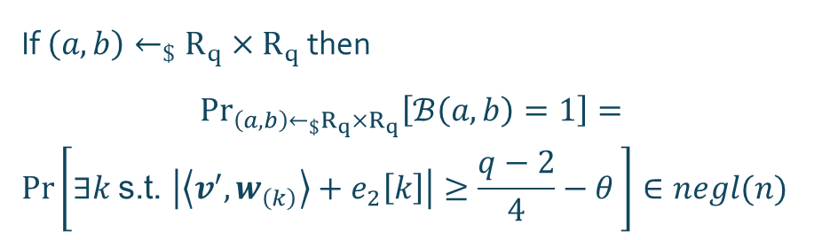
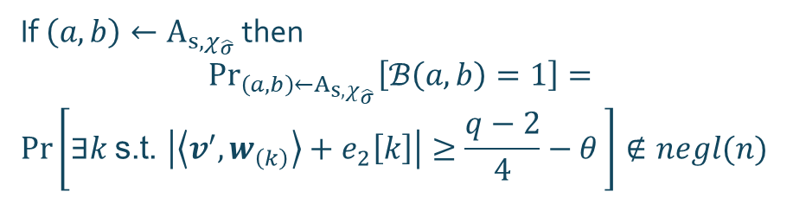
The RLWE Adversary
$$ℬ\left(a, b\right):$$
$s^{′},e^{′}←χ_{σ^{′}}$
$b^{′}≔as^{′}+e^{′}$
${pk}^{′}≔\left(a,b+b^{′}\right)$
$\left(μ, \left(r, e_{1}, e_{2}\right)\right)←𝒜\left({pk}^{′}\right)$
$w^{⊺}≔\left[r^{⊺}, {e_{1}}^{⊺}\right]$, ${v^{′}}^{⊺}≔\left[{e^{′}}^{⊺}, −{s^{′}}^{⊺}\right]$
$θ≔θ\left(n,\left\|w\right\|\right)$
if $∃k$ s.t. $\left|\left\langle v^{′}, w_{\left(k\right)}\right\rangle +e_{2}\left[k\right]\right|≥\frac{q−2}{4}−θ$
return $1$
else
return $0$
If $\left(a, b\right)←_{\$}R_{q}×R_{q}$ then
$${Pr}_{\left(a, b\right)←_{\$}R_{q}×R_{q}}\left[ℬ\left(a, b\right)=1\right]=$$
$$Pr\left[∃k \text{s.t. }\left|\left\langle v^{′}, w_{\left(k\right)}\right\rangle +e_{2}\left[k\right]\right|≥\frac{q−2}{4}−θ \right]∈negl(n)$$
If $\left(a, b\right)←A_{s,χ_{\hat{σ}}}$ then
$${Pr}_{\left(a, b\right)←A_{s,χ_{\hat{σ}}}}\left[ℬ\left(a, b\right)=1\right]=$$
$$Pr\left[∃k \text{s.t. }\left|\left\langle v^{′}, w_{\left(k\right)}\right\rangle +e_{2}\left[k\right]\right|≥\frac{q−2}{4}−θ \right]∉negl(n)$$
$${Adv}_{Π}^{RLWE}\left(ℬ\right)∉negl(n)$$

Slide 36
Open Problems
We focus on lattice-based PKE schemes. Can a similar reduction be proven for PKE schemes based on different hardness assumptions?

