Slide 1
On the Hull Attacks against Construction A Lattices
Jean-François Biasse, Alexandra Hostetler, Anuvrat Jainndungarwal

Slide 2

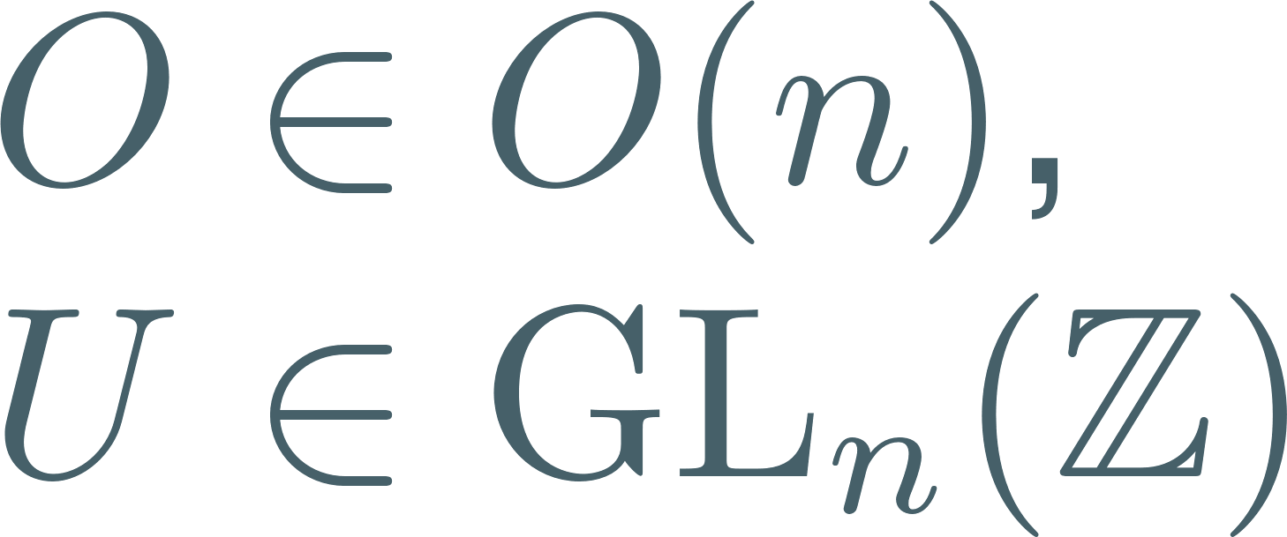

The Lattice Isomorphism Problem
Goal: Find a linear isometry between to given lattices.

Slide 3




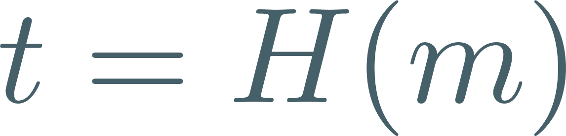
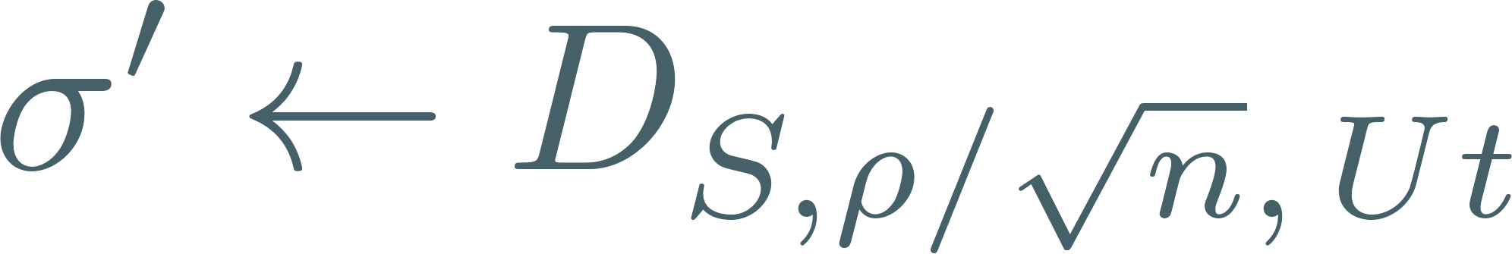




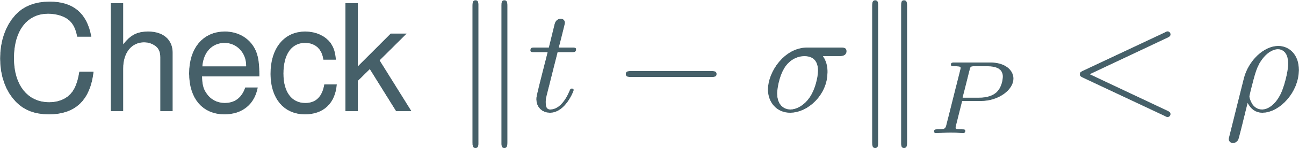
Digital signature with LIP (DvW22)

Slide 4
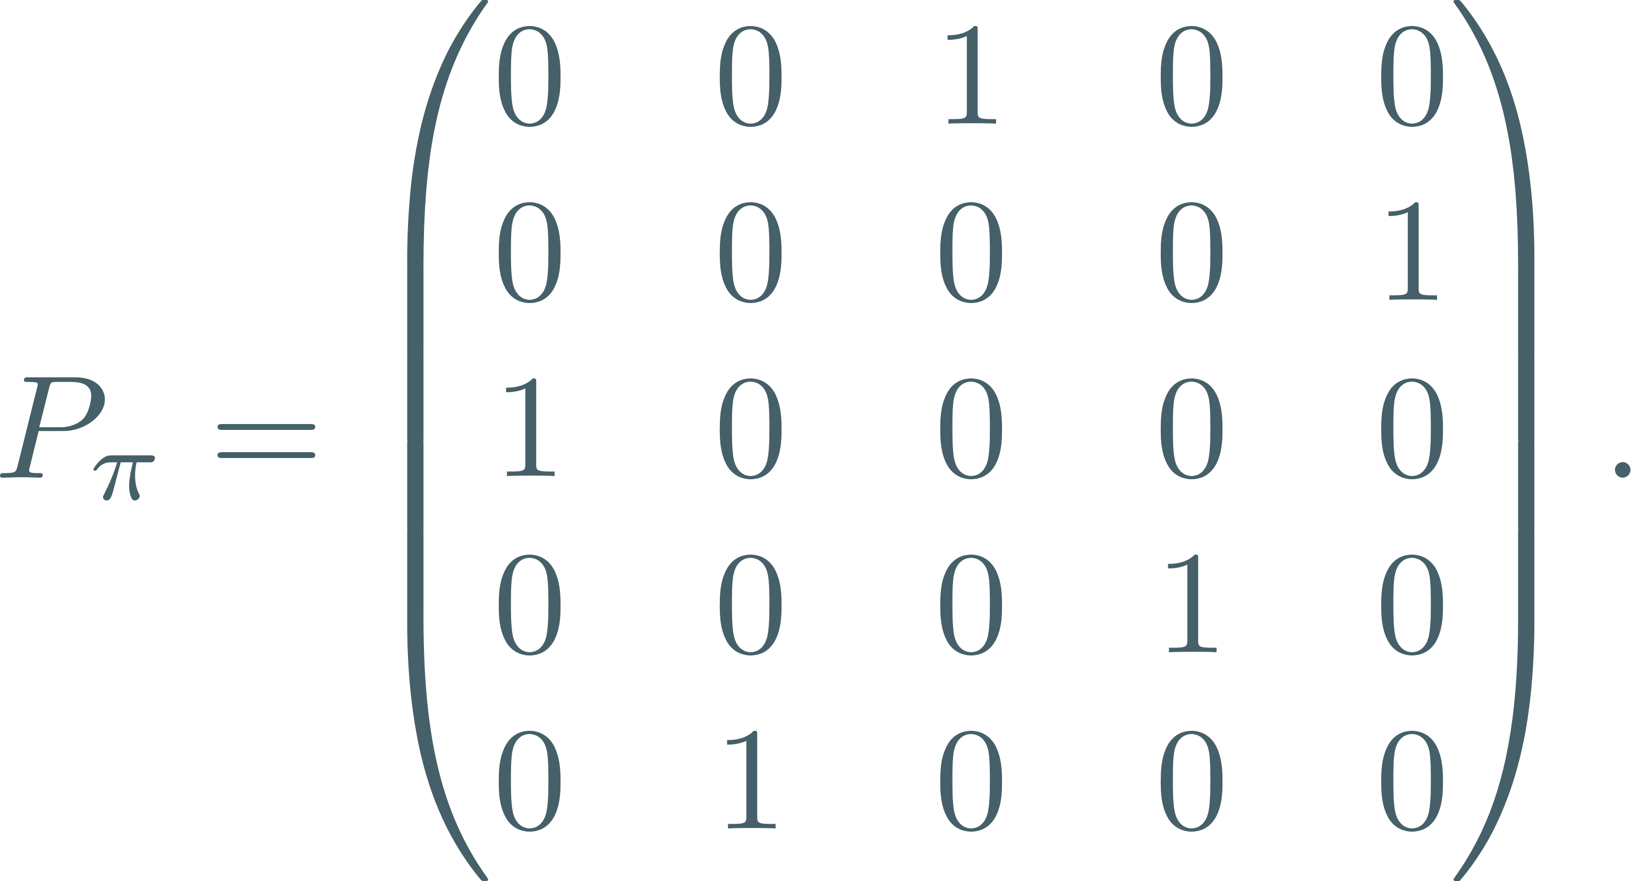
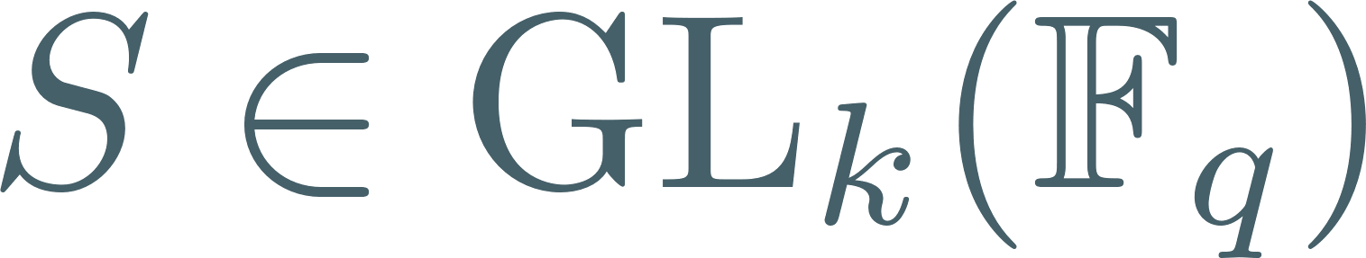
Permutation code equivalence

Slide 5

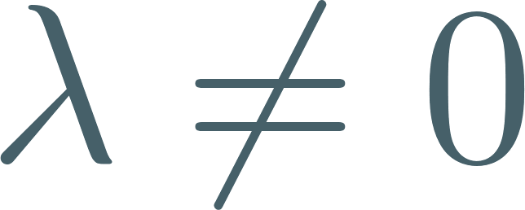
Generalizing permutation equivalence
Signed Permutation Equivalence (SPEP):
Permute then scale by
Linear Equivalence (LEP):
Permute then scale by

Slide 6


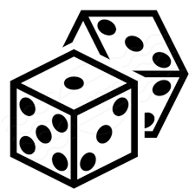
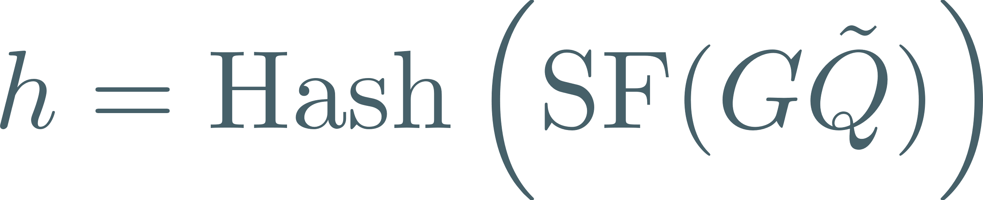

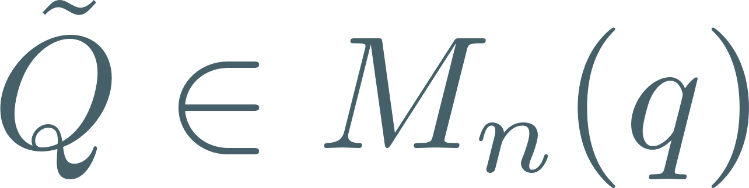
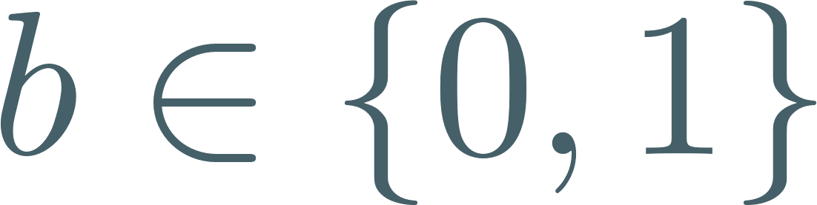

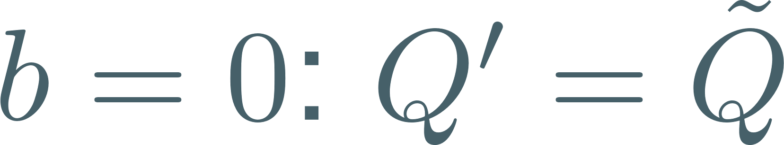


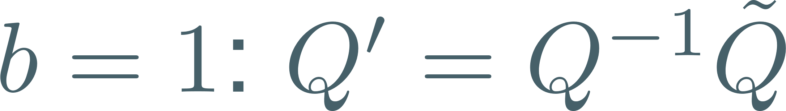

The LESS signature scheme (BMPS20)

Slide 7
Difficulty of these problems
Petrank-Roth 97: all unlikely to be NP-complete

Slide 8
Known reductions between problems
GI: Graph Isomorphism
BW25 and CSV25

Slide 9
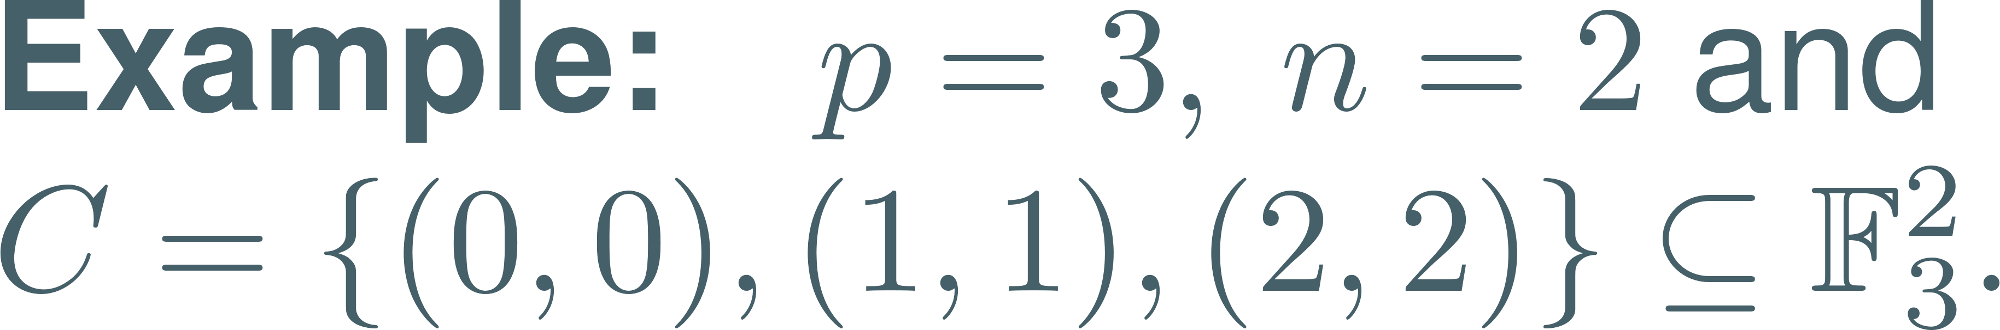
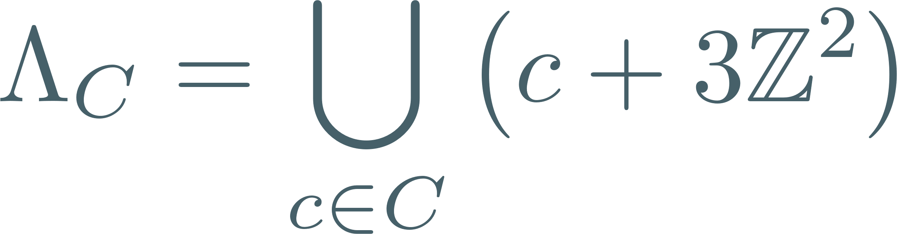
Construction A lattice

Slide 10
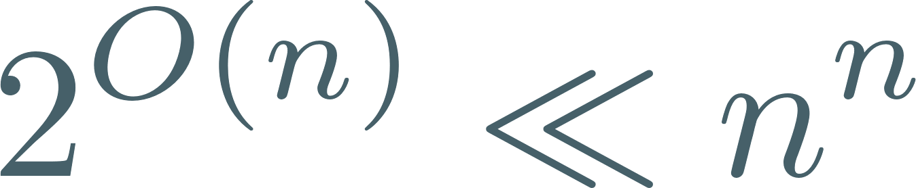
Main result of the paper
Input:
Output:
The algorithm makes
2 calls to Z-LIP
1 call to SPEP
Complexity:

Slide 11
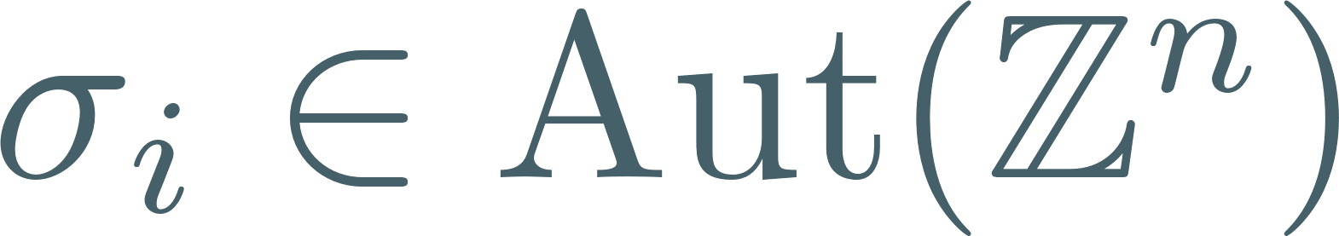
Algorithm

Slide 12
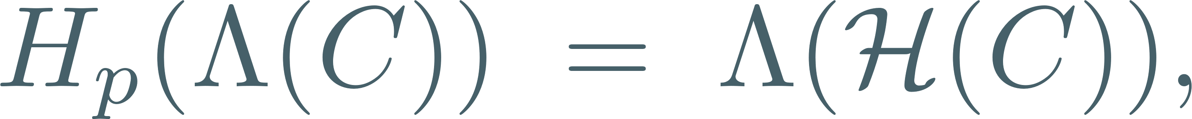
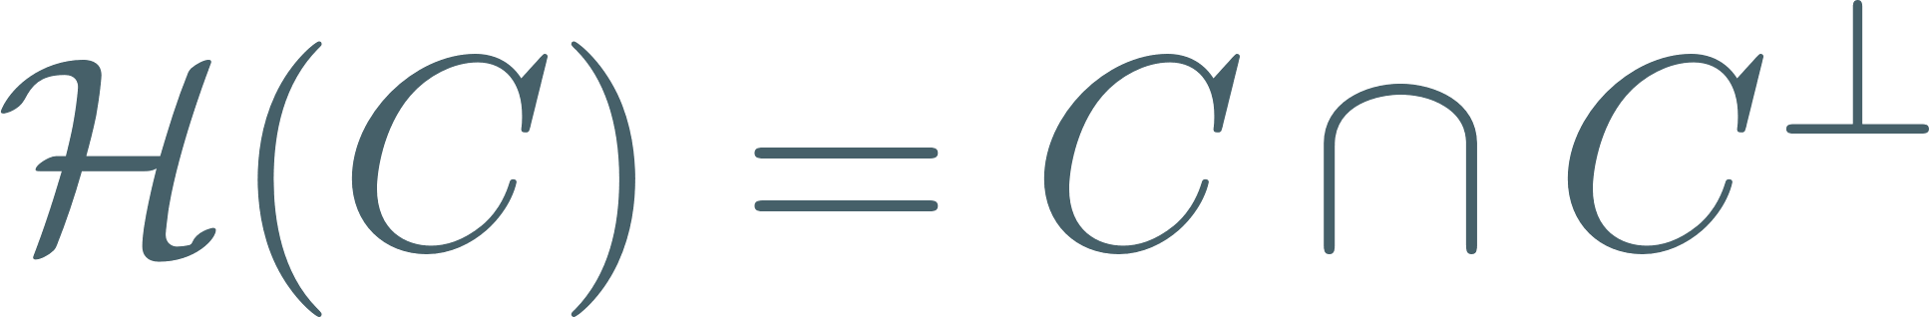
Main challenge
Ducas-Gibbons 23: restrict to lattices with trivial s-hull

Slide 13

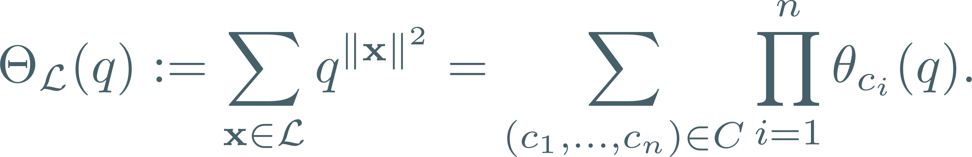
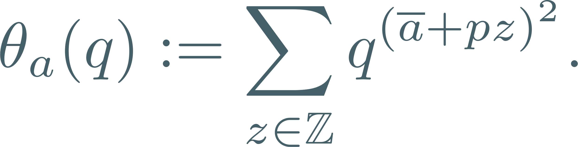
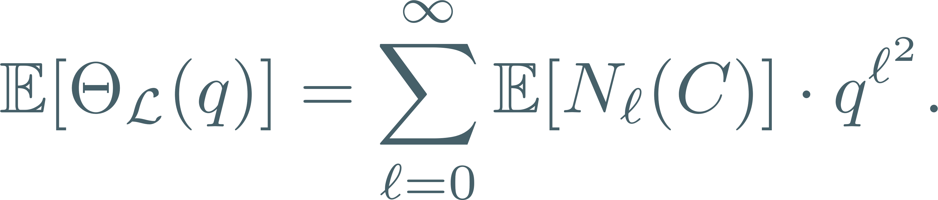


The expected number of p-length vectors

Slide 14
Example: vectors of norm p=3

Slide 15
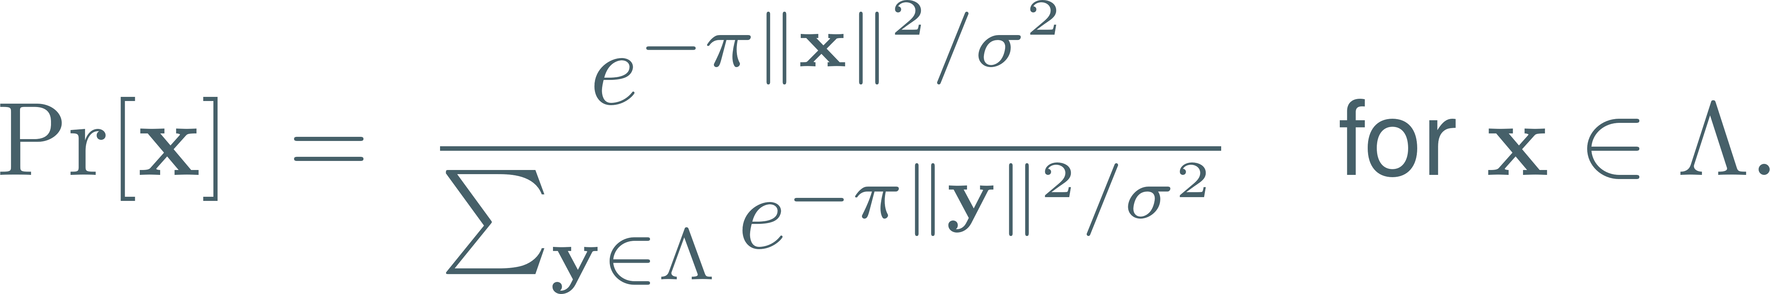


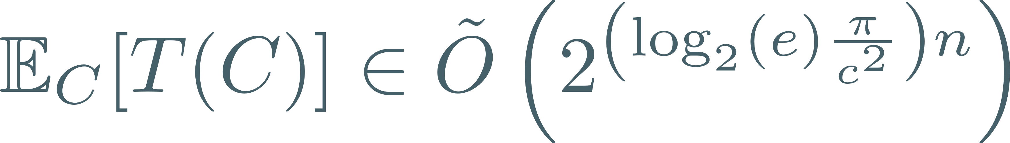
Collecting vectors of length p

Slide 16

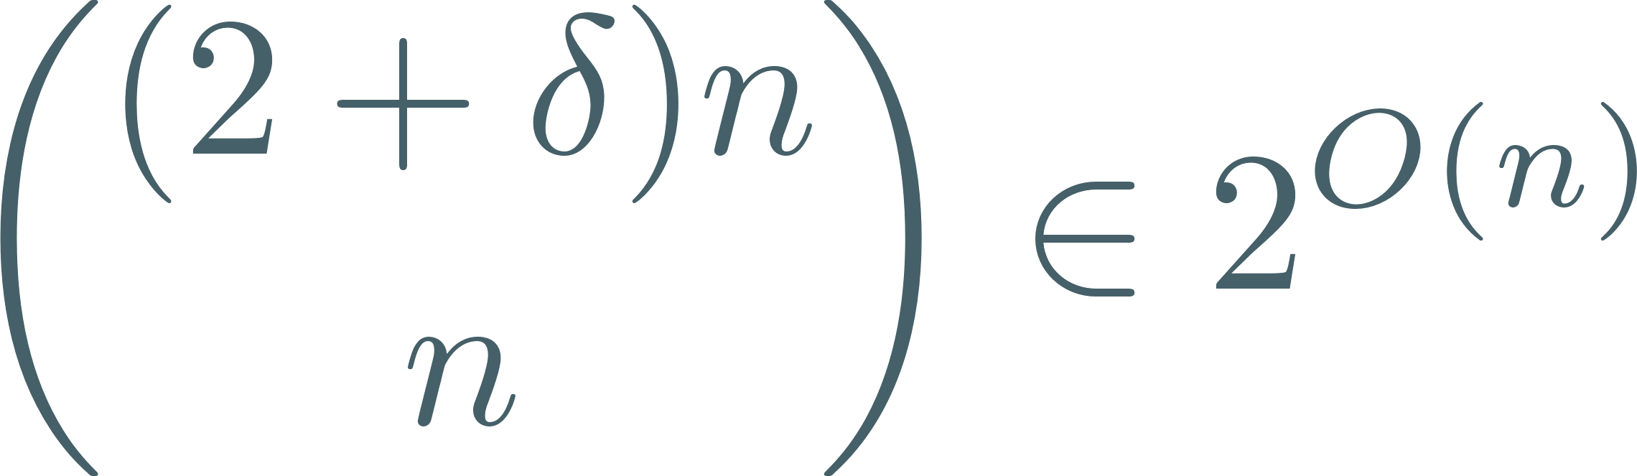
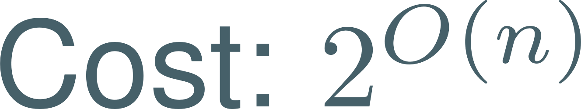
Overall time

Slide 17
Conclusion

Slide 19
Digital signature with LIP (DvW22)

