Slide 1



Performance Analysis of Parameterizable
HQC Hardware Architecture
Nishant Pandey, Sanjay Deshpande, Dixit Dutt Bohra, Debapriya Basu Roy, Dip Sankar Banerjee, and Jakub Szefer

Slide 2







Quantum Threat and Post-Quantum Cryptography
Public-key cryptography
  Shor’s algorithm can potentially break existing pre-quantum public-key cryptosystems (e.g., RSA)
Post-Quantum Cryptography to the rescue!
  Algorithms run on classical computers
Post-Quantum Cryptography standardization efforts are in progress around the world

Slide 3
NIST Post-Quantum Cryptography Standardization
ML-KEM standard
published
Concluded
1 PQ-KEM
(Hamming Quasi-Cyclic)
candidate selected
Round 3
1 PQ-KEM (Kyber), 3 PQ-DSS selected
4 PQ-KEM for further evaluation
Call for proposals
Round 1
Round 2
69
26
8
1
2016
2017
2018
2019
2020
2021
2022
2023
2024
2025
2026
40
14
9
ongoing
Call for proposals
Additional PQ-DSS
Round 1
Round 2
Round 3
Submitted candidates belong to two categories
  PQ-KEM: Post-Quantum Key Encapsulation Mechanism
  PQ-DSS: Post-Quantum Digital Signature Scheme
Evaluation Criteria
  Security
  Hardware and Software implementation efficiency and security
  Cost (key size, signature size, etc.)

Slide 4
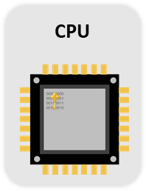
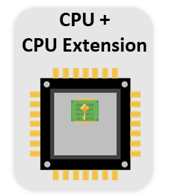
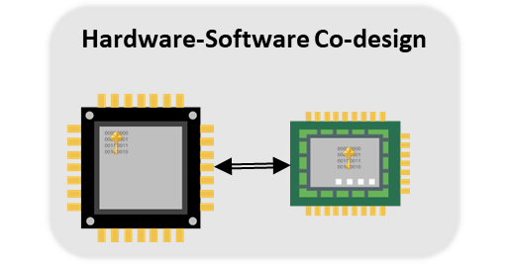
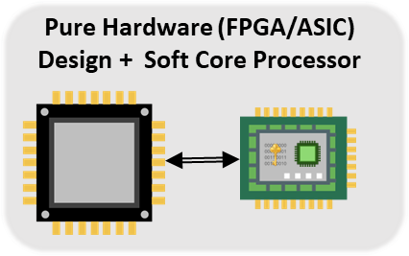
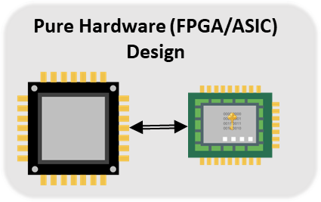
Secure and Efficient Implementations of Cryptographic Algorithms
Target platforms:
  CPU
  Microcontrollers
  Field-Programmable Gate Array (FPGA) : Artix 7
  Application Specific Integrated Circuit (ASIC)

Slide 5
Hamming Quasi-Cyclic
(HQC)

Slide 6





Key Encapsulation Mechanism
Alice’s
Public Key
A_{PK}
(A_{PK}, A_{SK})←KeyGen(seed)
Encapsulated Key
Alice’s
Secret Key
C
(K, C)←Encap(A_{PK})
K’←Decap(A_{SK}, C)
Ciphertext
Decapsulated Key
Secure Channel
Symmetric Encryption

Slide 7
Hamming Quasi Cyclic (HQC)
A code-based KEM scheme based on the syndrome decoding hard problem.
Construction is based on concatenated codes:
  Shortened Reed Solomon code and
  Duplicated Reed-Muller code
Parameter Set | Security | n | w | |ek| | |dk| | |ct|
HQC-1 | 128 | 17,669 | 66 | 2,241B | 2,321B | 4,433B
HQC-3 | 192 | 35,851 | 100 | 4,514B | 4,602B | 8,978B
HQC-5 | 256 | 57,637 | 131 | 7,237B | 7,333B | 14,421B
n - degree of the polynomial
w - weight
keypair – (ek,dk)
ct - ciphertext

Slide 8
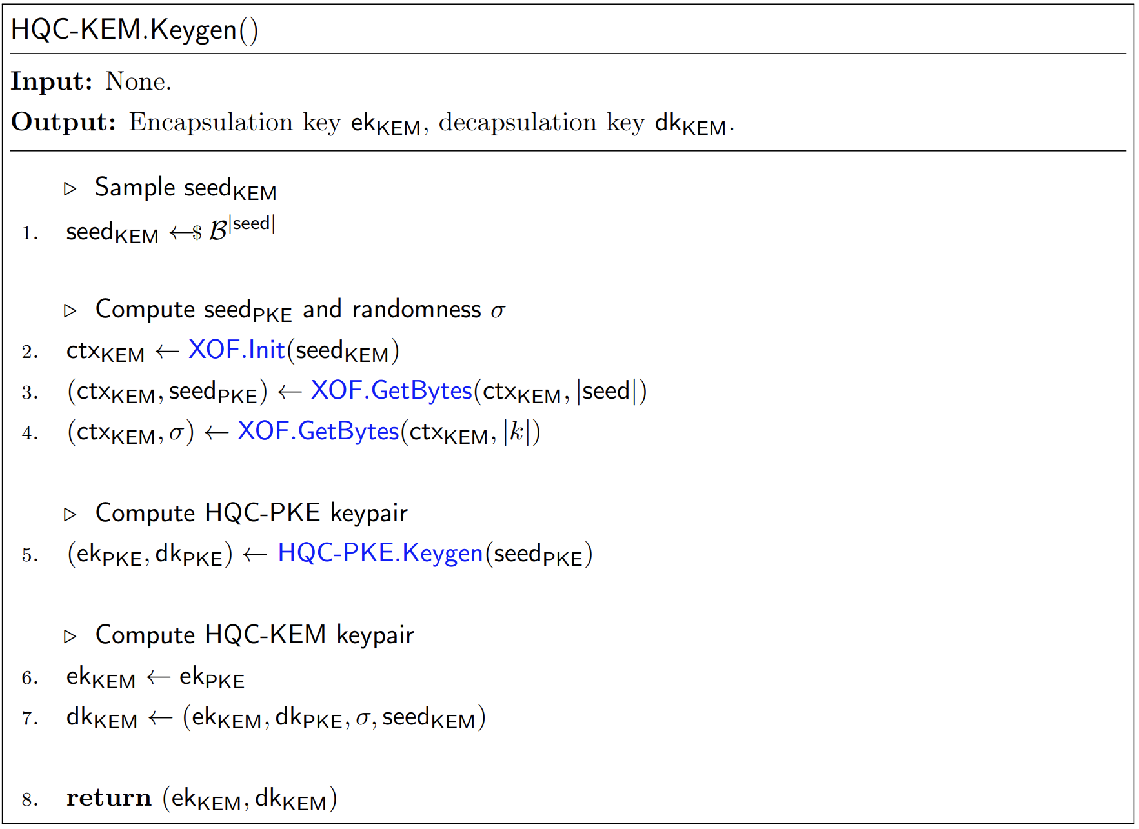
Key Generation
Sample
public key seed
(Seed_{PKE.ek})
h
Polynomial Multiplication
(h.y)
Polynomial Addition
x+h.y
s
Sample
Fixed
Weight
Vectors
y
secret key seed
(Seed_{PKE.dk})
ek_{PKE} = (h,s)
dk_{PKE} = (x,y)
x

Slide 9
HQC Primitives
Key Generation
Encapsulation
Performance Bottleneck.
95-96% across different parameter sets
Decapsulation

Slide 10
Limitations of Existing Work
HQC-1
Existing work includes
  Full hardware [SAC’23, HOST’24]
  High-level synthesis [CBCrypto’23]
  Hardware-Software codesign [WF-IoT’23]
Higher is better

Slide 11
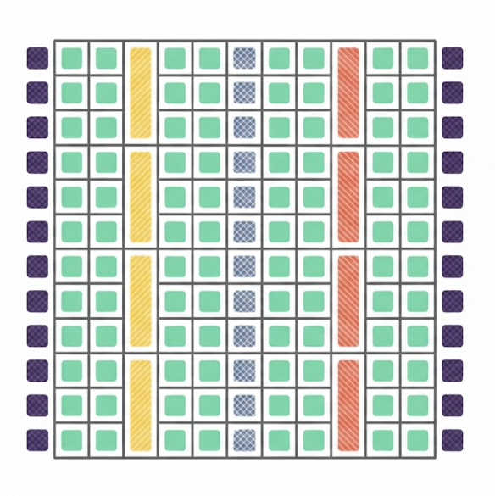
FPGA Implementation Performance and Evaluation Metrics
Time
Area
Area-Time product
  Time * {max{LUT/4, FF/8} + 128 ∗ BRAM + 100 ∗ DSP}
DSP Blocks
Input/Output
connections
a
LUT
out
b
MUX
clk
FF
Configurable logic block
(CLB)
Typical FPGA
Architecture
Memory Blocks
(Block RAM)

Slide 12
Limitations of Existing Work
HQC-1
Existing work includes
  Full hardware [SAC’23, HOST’24]
  Hardware-Software codesign [CBCrypto’23]
  High-level synthesis [WF-IoT’23]
Previous implementations lack
  Tweakable performance parameters
  Support for new parameter sets
Higher is better
Lower is better

Slide 13
Performance Bottleneck
Fixed-Weight Vector

Slide 14

Fixed Weight Vector – Constant Weight Word Method
Constant time method proposed by Sendrier [SEN21].
PRNG
start
index[i] = i+ prng_bits %(N-i)
i+1
Weight
== w?
[SAC’23]
Technique: Brute-force pairwise comparison.
Complexity O(w^2)
[Our]
Technique: One-pass traversal technique – trades off space for speed
Complexity: O(w)
Duplicate
Check?
pos = i
pos = index[i]
done
set the position
value to ‘1’
{0,1,0,0,0,1,0,0,…,0}

Slide 15
Fixed Weight Vector Generation - Evaluation
HQC-1
HQC-1
Lower is better
Lower is better

Slide 16
Performance Bottleneck
Polynomial Multiplication

Slide 17
Polynomial Multiplication
A & B are polynomials in F₂
A(x)=a₀​+a₁​x+a₂​x²+⋯+a_{n}​x^{n}
B(x)=b₀+b₁x+b₂x²+⋯+b_{n}x^{n}
Parameter Set | n | w
HQC-1 | 17,669 | 66
HQC-3 | 35,851 | 100
HQC-5 | 57,637 | 131
Schoolbook = O(n²)
Karatsuba = O(n^{1.585})
Toom-Cook = O(n^{1.465})

Slide 18
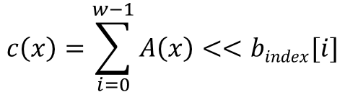
Polynomial Multiplication involving Sparse Polynomials
A & B are polynomials in F₂
A(x)=a₀​+a₁​x+a₂​x²+⋯+a_{n}​x^{n}
B(x)=0+b₁x+0+⋯+b_{m}x^{m}
$$c\left(x\right)=\sum_{i=0}^{w−1}{A\left(x\right)<<bindex[i]}$$
Parameter Set | n | w
HQC-1 | 17,669 | 66
HQC-3 | 35,851 | 100
HQC-5 | 57,637 | 131
Karatsuba = O(n^{1.585})
Toom-Cook = O(n^{1.465})
Sparse poly mult = O(n.w)

Slide 19
Sparse F₂ Polynomial Multiplication with Interleaved Reduction
Field polynomial: X^{n}-1: allows folding and adding the polynomial for reduction
The multiplication and the modular reduction is interleaved.
Reduction in area
Reduction in memory utilization
Sparse
Multiplication
Interleaved
Reduction
n
n
n
Variable
Shifter/ Rotation
2n
n
Non-Sparse
Polynomial Input
n
Output Polynomial
n
Non-zero bit position from Sparse Input
Addition is an XOR because all polynomials are in F₂.
Indices of non-zero elements are used to shift non-sparse polynomial to imitate the multiplication.
Conceptual Block Diagram

Slide 20
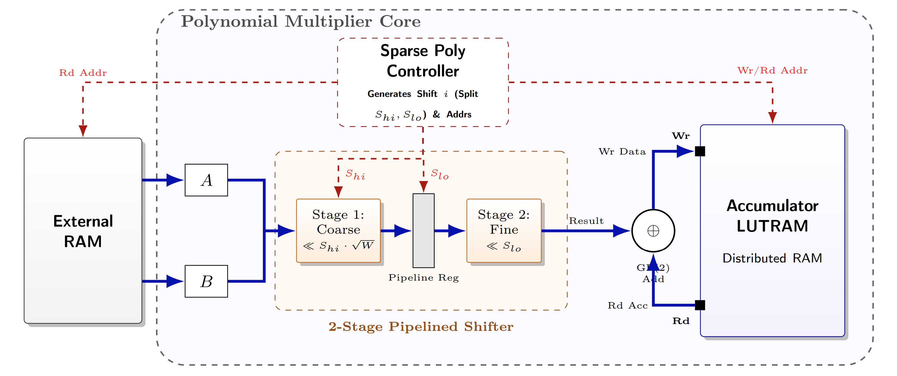
Sparse F₂ Polynomial Multiplication Hardware Design
W: Performance parameter [SAC’23]
HQC-1
Lower is better
Shifter
Block
RAM
HQC-1
Hardware design of sparse polynomial multiplication module
Lower is better

Slide 21
Key Generation, Encapsulation,
and Decapsulation

Slide 22

Joint Design – Sweep
FPGA: AMD Artix 7
HQC-1
Joint Design – combines Keygen, Encap, and Decap into one.
Shared module among different primitives.
  SHAKE256
  Polynomial Multiplication
  Encapsulation
  Polynomial Addition
W – performance parameter
Time-Area product
  Time * max{LUT/4 + 128 ∗ BRAM + 100 ∗ DSP, FF/8}
Higher is better
Lower is better

Slide 23
Joint Design – Comparison with other HQC Hardware Designs
FPGA: AMD Artix 7
HQC-1
Higher is better
Only Poly. Mult. on FPGA
Full design on FPGA
Lower is better

Slide 24
Summary
Key Generation
Encapsulation
Decapsulation
Design and evaluation of performance critical aspects of HQC implementation
When compared to state-of-the-art we demonstrated:
  20% improvement in Key Generation time
  80% improvement in Encapsulation time
  60% improvement in Decapsulation time
  33% improvement in the Time–Area product

Slide 25
Performance Analysis of Parameterizable
HQC Hardware Architecture
Thank you!
https://sanjaydeshpande.phd/

Slide 26

Backup
Slides

Slide 27
What about NTT/FFT type multiplication for HQC?
Cannot directly apply NTT (Number Theoretic Transform) to binary field polynomial multiplication
  Requires a finite field with special roots of unity
Chen et. al [CCK21] proposed using Frobenius Additive FFTs (FAFFT).
  Implemented in hardware by Ras et. al [RLC+25]

Slide 28
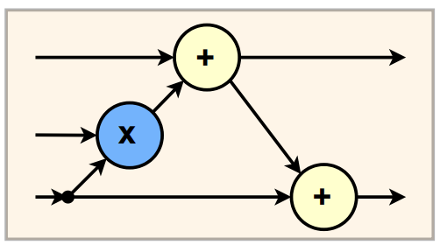
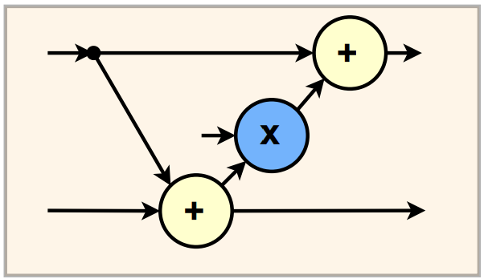
Frobenius Additive FFT (FAFFT)
Convert to new polynomial basis – Cantor Basis.
FFT Encode and FFT Decode are used to reduce the number of evaluations.
a
BC
FFT
Encode
FFT
Decode
BC
c
x
b
BC
FFT
Encode
F₂ -> F₂
FFT
IFFT
F₂ -> F₂
m
m

Slide 29
Performance FAFFT vs Sparse Multiplication
Taking advantage of sparsity doesn’t lead to non-constant time behavior on hardware.
  Weight of the sparse polynomial is fixed.
HQC128
1,877,897
Freq
(125 MHz)
(288 MHz)

Slide 30
Comparison HQC vs CRYSTALS-Kyber
Scheme | Sizes (Bytes)
 | ek | dk | ct
HQC128 | 2,241 | 4,602 | 7,333
Kyber512 | 800 | 1,632 | 768
Scheme | Device | Keygen | Encap | Decap | Freq. (MHz)
 |  | Kcycles
HQC-1 [GAA+25] | Intel Core i7-11850H | 76 | 150 | 353 | 2,500
Kyber-512 [ABD+21] | Intel Core i7-4770K | 34 | 45 | 35 | 3,492
Key Sizes
CPU Cycle Comparison
Scheme | Device | Keygen | Encap | Decap | Freq. (MHz) | Area
 |  | Kcycles |  |  |  | KLUT | KFF | DSP | BRAM
HQC-1 [our] | Artix-7 | 5 | 8 | 16 | 162 | 26 | 27 | 8 | 32.5
Kyber-512 [BMG+21] | Artix-7 | 2 | 3 | 5 | 220 | 10 | 9 | 4 | 4.5
FPGA Implementation Comparison

Slide 31
Syndrome Decoding Problem
h, 𝑥, 𝑦 are ‘n’ degree polynomials
Setup:
  h – sampled from a pseudo-random number generator (PRNG)
  𝑥, 𝑦 – non-zero location of the sparse polynomial sampled from a PRNG
𝑥
h
𝑦
S = 𝑥 + h .𝑦
+
x
=
pseudorandom polynomial
Sparse fixed-weight polynomial
Sparse fixed-weight polynomial
h and S are public
𝑥 and 𝑦 are secret
Given h and S, finding 𝑥 and 𝑦 is hard!

